Slide 1
Coal Seam Gas (CSG)
What is in it for Queensland?
Bruce Robertson
October 2019

Slide 2
Introduction
There is a global gas glut
Global prices for gas have collapsed, although Australian gas consumers are insulated from Global market downside
Demand for gas is falling in Australia
A cartel of gas industry players controls the price
Gas sets the price for electricity
The Australian market may become an import supplied market
Tax what tax?
The import terminal capacity over supply
Notes:
https://phys.org/news/2019-06-industrial-methane-emissions-higher.html
https://www.vox.com/energy-and-environment/2019/5/30/18643819/climate-change-natural-gas-middle-ground?mc_cid=1079379ee2&mc_eid=ca5790291b

Slide 3
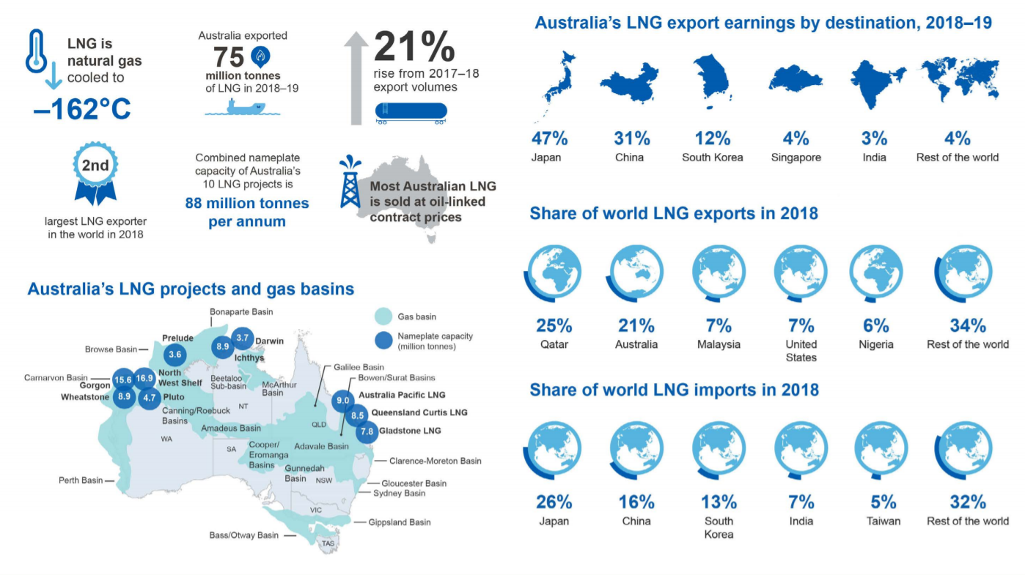
Gas/LNG Background
Notes:
Points to note
LNG is natural gas cooled to -162 degrees Celsius. Very Energy intensive
Most of the exports occur from the NW Shelf and NT
Australia is the second largest LNG exporter in the world accounting for 21% of exports
Japan is the biggest market and it is shrinking
https://publications.industry.gov.au/publications/resourcesandenergyquarterlyseptember2019/documents/Resources-and-Energy-Quarterly-September-2019.pdf

Slide 4
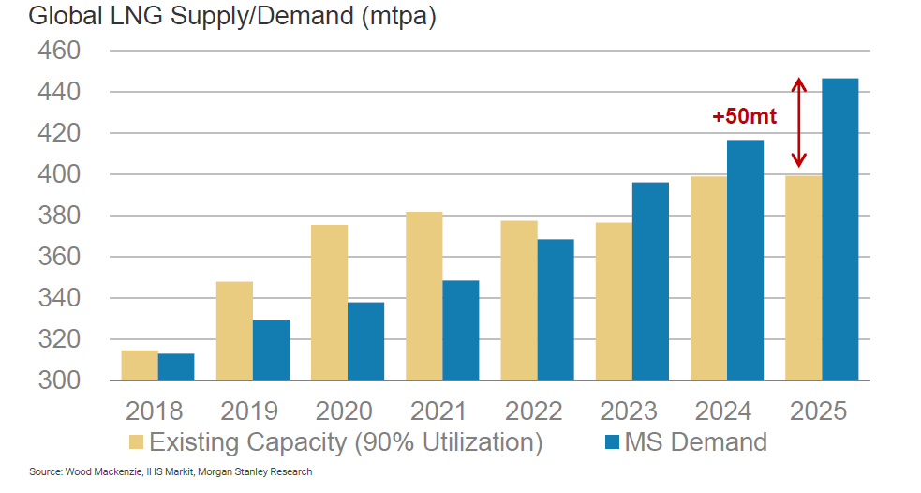
The Global Gas Glut out to 2023
I
Notes:
Page 35
Morgan Stanley
Global Energy -Natural Gas: Fuelling Global Disruption

Slide 5
US Government sourced global LNG prices
(Note US$4.45 /mmbtu is AU$6.30/GJ)

Slide 6
Gas Prices in Australia are amongst the highest on the globe
Prior to 2015 the east coast of Australia had a stable domestic market for gas with reasonable prices of $3-4/GJ
With the advent of the construction of the six trains at Gladstone domestic gas prices increased rapidly to peak at $21/GJ in early 2017.
Prices have now come down and stand at between 8-12/GJ according to the Australian Competition and Consumer Commission (ACCC)

Slide 7
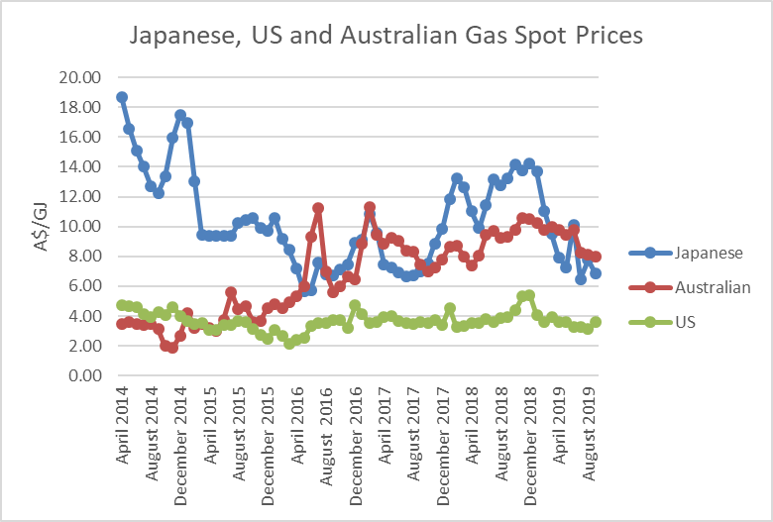
Australian gas prices globally uncompetitive
Notes:
Sources: AEMO, EIA and METI

Slide 8
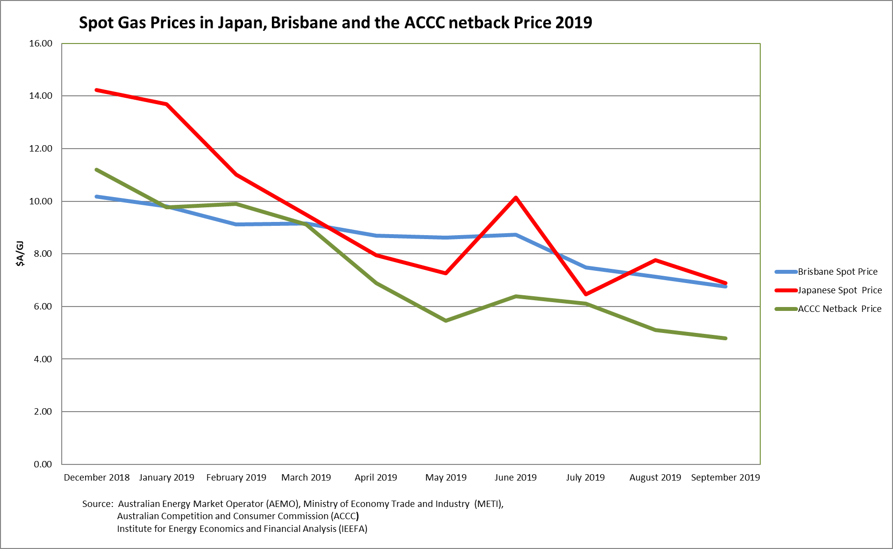
ACCC Netback price indicates the price we should be paying
Notes:
https://www.accc.gov.au/regulated-infrastructure/energy/gas-inquiry-2017-2020/lng-netback-price-series

Slide 9
Spot Gas Prices in Queensland
The current spot gas price in Queensland is 7.82/GJ (25th October)
The ACCC netback price in October is $5.19/GJ
Queensland gas consumers are paying 51% more than export parity prices according to the ACCC

Slide 10
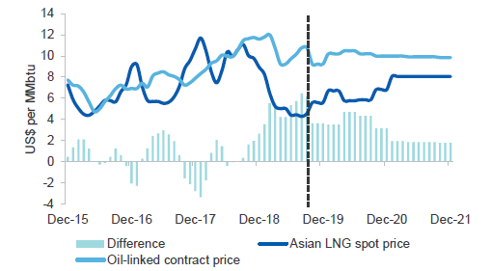
Contract Gas & Spot Prices in Asia
Notes:
4 points to note
Our Asian customers are paying around US$10/mmbtu for contract gas and US$4/mmbtu for spot gas
This is an unsustainable situation and there is pressure on the oil linked contracts
Liquefying gas is very expensive ($4/GJ plus $0.70 shipping)
US supply is forcing the prices down
Source: Resources and Energy Quarterly September 2019 Page 56

Slide 11
Australia’s Gas market controlled by a Cartel
Prices for Spot and Contracted gas in Australia bear no relationship to either production costs or to international prices
The east coast gas market does not exist.
The gas cartel controls the price and sets it at levels far in excess of global parity
Notes:
https://www.aemo.com.au/Gas/Short-Term-Trading-Market-STTM/Data-dashboard
https://www.accc.gov.au/regulated-infrastructure/energy/gas-inquiry-2017-2020/lng-netback-price-series
https://www.spglobal.com/platts/en/our-methodology/price-assessments/natural-gas/jkmt-japan-korea-marker-gas-price-assessments

Slide 12
Australia to become an import supplied market!?
The extent of the gas price gouge means it is now economic to import gas into Australia.
There are currently five gas import terminal proposals in Australia.
If all are built, they will have the capacity to supply 88% of Australia’s east coast market. Australia - the world’s largest gas exporter - will be an import supplied market.
Notes:
Total Domestic market 559 PJ in 2019
Total import Terminals 490 PJ
NSW import terminals 290PJ pa versus market in NSW of 116PJ!
Source of NSW market size is AEMO 2019 Gas Statement of Opportunities page 20 Table 5

Slide 13
Australian Gas Import terminals – Oversupply?
Notes:
Total Domestic Gas Production in 2018 574PJ (source:http://forecasting.aemo.com.au/Gas/AnnualConsumption/Total)
Proposed Gas Import Terminals estimated Capacity 490PJ

Slide 14
Climate Change effects of LNG & Importing Gas
LNG industry uses around 3.2% of the total demand for Electricity on the East Coast of Australia
Gas used in exports at Gladstone 150PJ which is equivalent to 28% of the entire domestic gas consumption in Eastern Australia
Notes:
Source AEMO
Page 41 Electricity Statement of Opportunities 2018
Page ix (in low scenario) https://www.aemo.com.au/-/media/Files/Gas/National_Planning_and_Forecasting/GSOO/2018/Projections-of-Gas-and-Electricity-Used-in-LNG-2017-Final-Report-19--12-17.pdf
http://forecasting.aemo.com.au/Gas/AnnualConsumption/Total

Slide 15
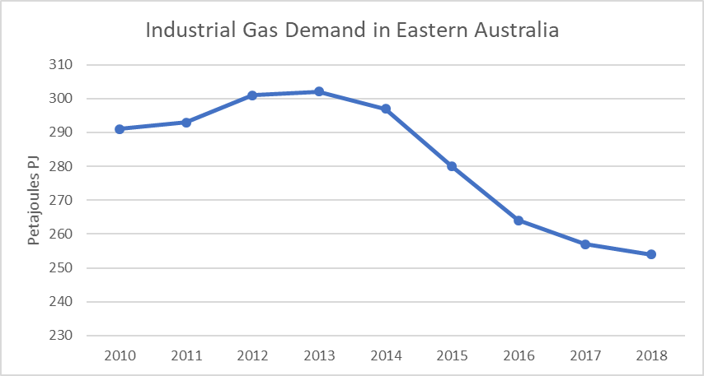
Industrial Gas Demand is falling
I
Notes:
Source: AEMO
Industrial demand is down 14% since 2014

Slide 16
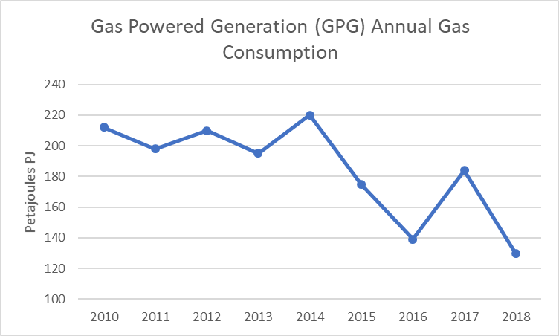
Gas Powered Generation demand plummets
I
Notes:
Source: AEMO
Gas powered generation demand is down 41% since 2014

Slide 17
Gas sets the price for electricity in the National Electricity Market
Gas sets the price for electricity in the NEM as it is the highest cost producer. High gas prices have led to very high wholesale power prices.
Gas prices have tripled in recent years. The ACCC has estimated that for every $1 rise in the gas price, the wholesale price rises by up to $11/MWh.
If we had a domestic gas reserve at $5/GJ average wholesale electricity prices would almost halve.
Retail electricity bills would fall by $270pa
Commercial and Industrial consumers of electricity would see their bills fall by 27%

Slide 18
What taxes and royalties were promised
Catherine Tanner, CEO of BG Group stated in October 2010
"We also expect to pay about $1 billion a year in federal taxes and a further $300 million or so each year in royalties to the Queensland government," Ms Tanna said today.
Her optimism was shared by the premier
Queensland Premier Anna Bligh says BG Group's announcement would mean billions of dollars for the state's economy.
Source: https://www.news.com.au/finance/bg-group-announces-15bn-lng-project/news-story/cca9d568605dee097d4e8489315ac357

Slide 19
Royalties what royalties?
In the 2014 budget petroleum royalties were expected to rise from $68m in 2013-14 to $660m by 2016-17 on the back of the boom in Coal Seam Gas (CSG). The result was a fraction of the expectation at just $98m in 2016-17.
Royalty take by the Queensland government has been so disappointing that the rate was increased from 10% to 12.5% starting in 2019-20
The 2019-20 State budget stated that the estimated actual royalty take from the Petroleum sector was $450m in 2018-19. Finally some royalties are being paid although a fraction of what was expected.
Notes:
Increase in royalties page 72 - https://budget.qld.gov.au/files/4.%20Revenue.pdf
Estimated actual royalty take in 2018 -19 Page 86 - https://budget.qld.gov.au/files/4.%20Revenue.pdf

Slide 20
Taxes what taxes?
Taxes on the other hand have been minimal. Far from the $1 billion in tax that BG’s Tanna said her company would pay, in 2016-17 BG group paid no tax. BG has been taken over by Shell and it too paid no tax in 2016-17.
The other 2 consortium that own plants at Gladstone are led by Santos and Origin neither of which paid tax in 2016-17 according to the ATO.
There simply has not been the billions of dollars for the Queensland economy that were promised.
Notes:
https://www.michaelwest.com.au/ato-tax-dump-reveals-the-dodgers-the-usual-suspects-shine/
https://data.gov.au/dataset/ds-dga-c2524c87-cea4-4636-acac-599a82048a26/details

Slide 21
Real Estate
An interview with a Gladstone Real Estate Valuer in May 2018
How would you characterise the local Gladstone market during this decline?
A: We have witnessed a very active mortgagee in possession market, and an oversupply of dwellings, townhouses and apartments.
Values of townhouses and apartments, in some cases, have declined up to 75%, with dwellings declining around 50% from peak values when they were originally purchased to now when they have recently re-sold.
With rapidly declining values and an increasing oversupply of housing we also saw a very active mortgagee in possession market
Notes:
https://www.opteonsolutions.com/au/gladstone-property-market-rise-fall-slow-rise/

Slide 22
How good is the LNG industry?
Total nameplate capacity of the 3 Gladstone projects is 25.4MT
Production in 2018 was 20.6MT
The three Gladstone projects are running 19% below capacity
For GLNG, the Santos owned project, the situation is even worse. GLNG is running 3MT below its nameplate capacity of 7.8MT
The CSG to LNG industry in Queensland got its costs horribly wrong
The CSG to LNG industry is a serial “Write Off” offender.
Notes:
https://publications.industry.gov.au/publications/resourcesandenergyquarterlyseptember2019/documents/Resources-and-Energy-Quarterly-September-2019.pdf
https://www.qrc.org.au/media-releases/new-record-for-qld-lng/
Source Santos 2018 annual report page 19
Production costs from https://www.accc.gov.au/system/files/Core%20Energy%20report%20for%20ACCC%20-%20November%202018.pdf
Production costs for CSG range from $4.00 to $6.70 according to this ACCC commissioned Core Energy report.

Slide 23
Constructive Policy Responses
A domestic gas reservation on existing and prospective fields at $5/GJ
A ban on gas for new housing developments
Programs to transition the domestic sector off gas
Programs to transition the industrial sector off gas
Increased renewables for electricity generation
Encouragement of the renewable Hydrogen sector
Better building standards – insulation, double glazing etc
A ban on import terminals

Slide 24
Conclusion- CSG- What is in it for Queensland?
Not a lot!

