Slide 1


Puerto Rico’s Electricity System,
Before and After Hurricane Maria
Cathy Kunkel and Anna Sommer
October 24, 2017

Slide 2

Outline
Background on Puerto Rico‘s energy system
Financial challenges
Hurricane Maria
Recommendations
2

Slide 3
Background: Puerto Rico’s electricity system
The Puerto Rico Electric Power Authority (PREPA) is the only utility in Puerto Rico.
Puerto Rico’s electricity mix (MWh):
3

Slide 4
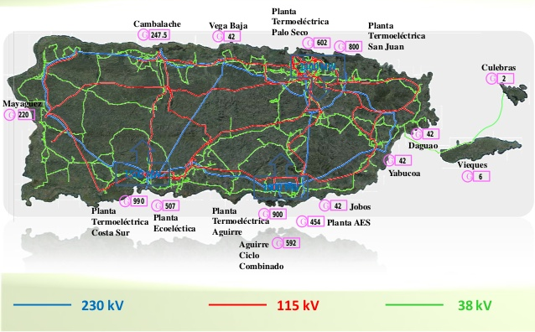
Puerto Rico’s electrical system

Slide 5
Renewable energy and distributed generation:
In 2010, legislature established renewable energy targets (Law 82-2010):
12% by 2015
15% by 2020
20% by 2035
No specific targets for distributed generation
In 2015, PREPA had 181 MW of utility-scale renewable energy – 3.3% of generation
PREPA has 136 MW of distributed generation
5

Slide 6
Renewable Energy and Energy Efficiency:
New and existing renewables would have equaled about 4% pf generation in 2020 under PREPA‘s most recent IRP-related filing
PREPA had committed to increasing incremental savings by 0.2 percent per year until 2025 when the incremental reduction would stabilize at 1.5 percent per year
EE goal arose from prior Commission order, but it‘s not clear how seriously PREPA took this goal since it never filed an implementation plan
6
Notes:
Should mention that there’s no plan for actually getting to 16% by 2020 and the IRP wasn’t actually proposing to achieve that.

Slide 7
Challenges facing PREPA (before Hurricane Maria):
Old oil-fired power plants are not in compliance with U.S. air quality regulations
Significant deferred maintance on transmission and distribution system.
High retail electric rates -- approximately double average electric rate on U.S. mainland
Nearly $9 billion in debt, insolvent, unable to access capital markets
Lack of transparency and public accountability
Declining demand. Sales fell 5% from 2012-2016
Management problems: upper management turnover, loss of competent staff, lack of appropriate oversight over contracts and fees
7
Notes:
For management problems, could talk about the terrible renewable energy contracts

Slide 8
Challenges facing PREPA (before Hurricane Maria):
Part of PREPA’s financial difficulties stem from higher than normal losses. Technical losses are due to T&D system, while non-technical losses arise from customers that do not pay for their power.
8

Slide 9
Future of Puerto Rico’s electricity system:
PREPA‘s plan for 2035, presented to Energy Commission in 2015 is focused on centralized natural gas generation, including construction of a $400 million LNG import terminal
PREPA aiming to achieve only 15% utility-scale renewable energy by 2035
9

Slide 10
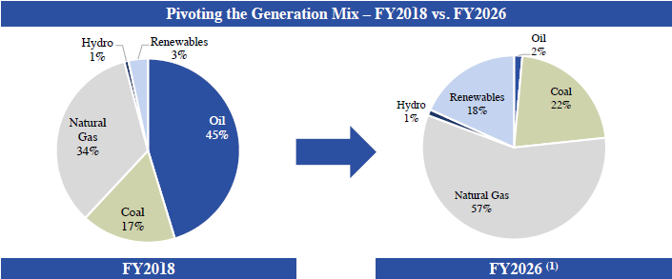
PREPA’s renewable energy plans:
PREPA‘s April 2017 Fiscal Plan (for utility-owned generation):
10
Notes:
Note that this is not the same plan as presented to Energy Commission

Slide 11
Utility Regulatory History of PREPA
Puerto Rico Energy Commission established in 2014
First IRP case in 2015
First rate case in 2016
11

Slide 12
PREPA’s debt
PREPA has approximately $9 billion of debt
  Over $2 billion insured
  3 categories of bondholders:
    Large investment firms (Oppenheimer, Franklin Templeton, JP Morgan)
    Hedge funds
    Small investors
Total assets of bondholders > $8 trillion
Questions about legality of the debt
  Underwriters, financial advisers may be liable
  SEC investigating fraud and misrepresentation in PREPA bond issuances
These questions not asked by PREPA‘s debt restructuring consultant
12
Notes:
Liability for failures to do due diligence on bond issuances

Slide 13
Impact of debt on electricity system and ratepayers
Why debt was incurred
  Borrowing to pay operating expenses, esp. Oil costs
  Political interference in PREPA
  Make up for declining electricity sales
  NOT for capital investment in generation and transmission system
Debt repayment is crowding out needed investment
  Approximately 24% of FY 2017 rate to pay off legacy debt
  Desperate need for infrastructure investment pre-hurricane
12

Slide 14
Proposed debt restructuring
PREPA and bondholders reached proposed debt restructuring agreement
  Less than 15% reduction in principal
  First lien on PREPA revenues
Negotiated debt restructuring required PROMESA Board approval
PROMESA Board estimated in January that Puerto Rico could afford about 20% of total government debt service in FY 2019
PREPA debt restructuring rejected by PROMESA Board in June 2017 – not affordable
PREPA placed into bankruptcy court
13

Slide 15
PREPA bankruptcy
Bankruptcy process is key to:
  Amount of PREPA legacy debt moving forward
  Restoring PREPA‘s access to capital markets
  Possible deals on future investments
Inappropriate use of bankruptcy process for attack on Energy Commission
  PREPA and PROMESA Board have argued to bankruptcy court that Energy Commission has overstepped authority and usurped PROMESA Board‘s powers
14

Slide 16
IEEFA’s Take on PREPA’s Plans in June 2017:
Everyone agrees demand will continue to go down, but the question is by how much
Virtually guarantees that rates will go up if significant capital is invested
16

Slide 17
IEEFA’s Take on PREPA’s Plans in June 2017:
Buildout of LNG port at Aguirre was fraught with uncertainties about when the plant would actually come online, what benefit would accrue to ratepayers, who was at risk for cost overruns, and who the contractors would be
A few months later, PREPA bankruptcy filing caused the main vendor for the LNG port to pull out of the project
In addition, it was going to be nearly impossible for PREPA to raise capital from the financial markets
17

Slide 18
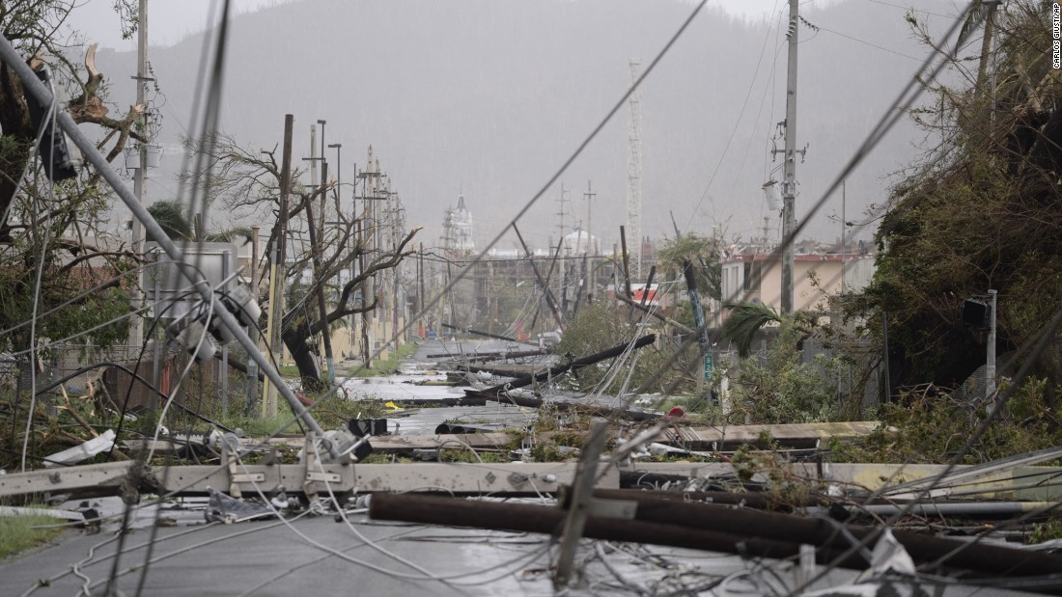
Hurricane Maria

Slide 19
Hurricane Maria
80% of transmission and distribution system seriously damaged
PREPA working with US Army Corps of Engineers to restore service
PREPA projects that it will take 6 months to restore service
Problems have arisen because of poor state of generation system before hurricane:
  Palo Seco plant damaged by earthquate in August 2017
  Problems at Palo Seco leading to difficulties in restoring power in San Juan area
19

Slide 20
Rebuilding the electrical grid
Army Corp of Engineers is largely tasked with rebuilding. Among their projects underway is establishing 50 MW of power generation at the Palo Seco site.
Additional contractors have been hired to rebuild transmission lines from generation in the south to population centers in the North.
Generators of all kinds experienced damage - limited to material -during the storm.
All indications are that PREPA is largely reconstructing the grid that existed before Maria.
20

Slide 21
Hurricane Maria and renewable energy
Highlights the need for microgrids and distributed generation
Must overcome institutional resistance to renewable energy; currently PREPA is spending more than $1 billion/year on off-island oil and gas interests
Coalition of business and environmental interests in Puerto Rico have been pushing for renewable energy and reform of PREPA for several years
21

Slide 22
Hurricane Maria and renewable energy
New interest from Puerto Rican government:
"Although the short term goal is to restore energy to the greatest number of people, we must not sacrifice the opportunity we have to have a power system that is resilient, modern and a global leader“ – Governor Rossello
Tesla is pushing Puerto Rican government to rebuild the grid with batteries and solar power
Sonnen plans to build subsidized microgrids for emergency centers
Many unanswered questions about PREPA’s legacy debt and how rebuilding will be financed
22

Slide 23
Recommendations
Prioritize affordability – need debt structure that can be supported
  Cancellation of legacy debt
  Reduction and eventual elimination of fossil fuel costs
Transition to greater reliance on microgrids, solar
Independent administrator for PREPA
23
Notes:
Management is driven by short-term political gain, imprudent use of debt -→ need independent management of PREPA for a period of time to restructure priorities, hire the right staff, clean out the wrong people, etc. This is how judicial system responds to tax fraud – independent, knowledgeable team comes in to clean up management disorder.

Slide 24
IEEFA reports on PREPA
  Testimony on Aguirre Offshore Gas Port, June 2017: http://ieefa.org/wp-content/uploads/2017/06/IEEFA-Sommer-Kunkel-Testimony-PREPA-Aguirre-Site-Economic-Analysis-PREC-060217.pdf
  Briefing Note, January 2017: http://ieefa.org/wp-content/uploads/2017/01/PREPA-Update-Brief-012417.docx.pdf
  Testimony in rate case, October 2016: http://ieefa.org/wp-content/uploads/2016/11/Testimony-Kunkel-Sanzillo.pdf
  Report on debt restructuring, August 2016: http://ieefa.org/wp-content/uploads/2016/08/PREPA-Debt-Restructuring-Deal-Won%E2%80%99t-Restore-Agency-to-Financial-Health-August-2016.pdf
  Report on electric system, Sept 2015: http://ieefa.org/wp-content/uploads/2015/09/Opportunity-for-A-New-Direction-for-Puerto-Ricos-Electric-System-Sept-10-2015.pdf
24

