Slide 1
State of International Electricity Markets & Stranded Asset Risk “The transition is underway and I see it as my job to ensure there is a smooth transition” Josh Frydenberg Minister of the Environment & Energy, August 2016
Tim Buckley, Director of Energy Finance Studies, Australasia (tbuckley@ieefa.org) i3
October 2016

Slide 2
AGENDA
The Global Electricity Market Transformation
Global coal demand - 2016
Global thermal coal demand in China declining
India – Electricity sector transformation
Renewables are deflationary
South Africa / Solar / technology gains / Underestimations
Coal prices have doubled from 2016 lows
Wood Mackenzie forecasts seaborne coal -40% by 2035 and thermal pricing at US$50/t – if COP21?
Adani Carmichael Coal Proposal
Notes:
In this presentation, I aim to talk about the transformation currently underway of the world’s electricity markets
Coal has historically been the mainstay fuel of the world’s main electricity markets.
However, with ever increasing amounts of gas, nuclear, hydro, wind and solar power being installed globally, plus the curtailment of electricity demand growth by greater energy efficiency impacts, the growth profile of coal is highly questionable.
My biggest forecast last year was that China would see peak coal consumption by 2016 – 15-20 years ahead of the IEA’s timeframe. Coal consumption was down 2% in 2014, despite 7.4% GDP growth and 3.8% electricity system demand growth. Something has changed fundamentally in 2014.

Slide 3
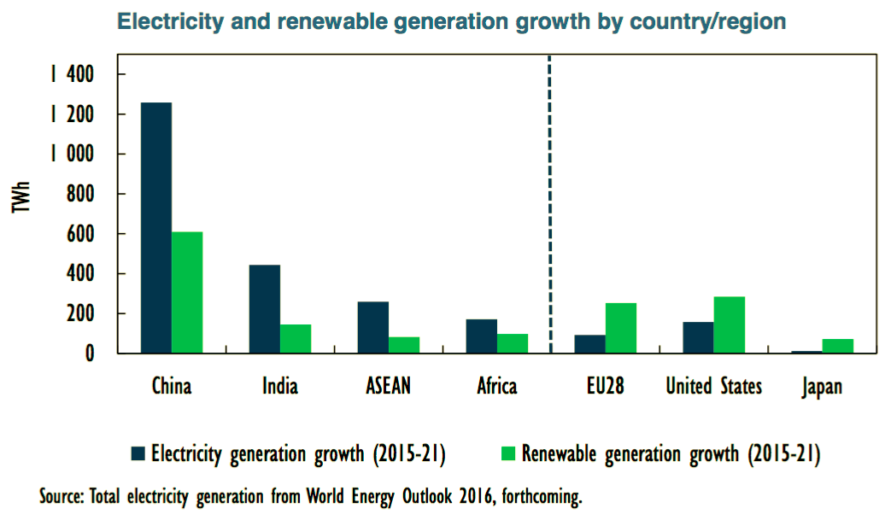
1.1 IEA
New IEA figures released overnight – upgrading world wind electricity forecast by 50% to 5,394TWh by 2040.
Notes:
China Shenhua Energy Co.’s Chairman last week reported:
“The pace of adjustments to the global energy structure in the short run will speed up and the trend of lowering the consuming proportion of fossil fuel energy will be obvious … the structural adjustments to the coal and electricity sectors will accelerate.”
That doesn’t sound like the largest coal company by value in the world has much doubt!

Slide 4
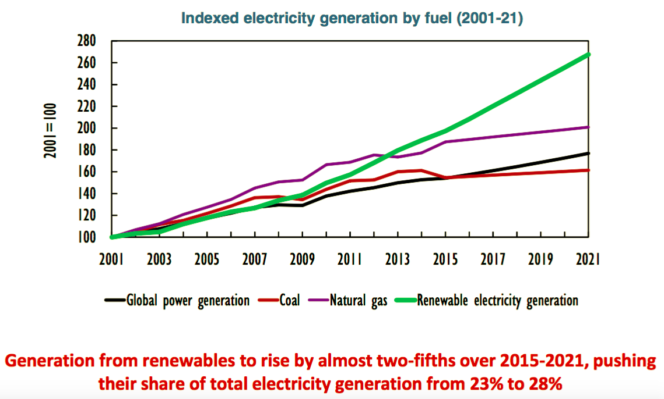
1.1 IEA
RE share gain of 1% pa – so 37% by 2030, 47% by 2040.
Notes:
China Shenhua Energy Co.’s Chairman last week reported:
“The pace of adjustments to the global energy structure in the short run will speed up and the trend of lowering the consuming proportion of fossil fuel energy will be obvious … the structural adjustments to the coal and electricity sectors will accelerate.”
That doesn’t sound like the largest coal company by value in the world has much doubt!

Slide 5
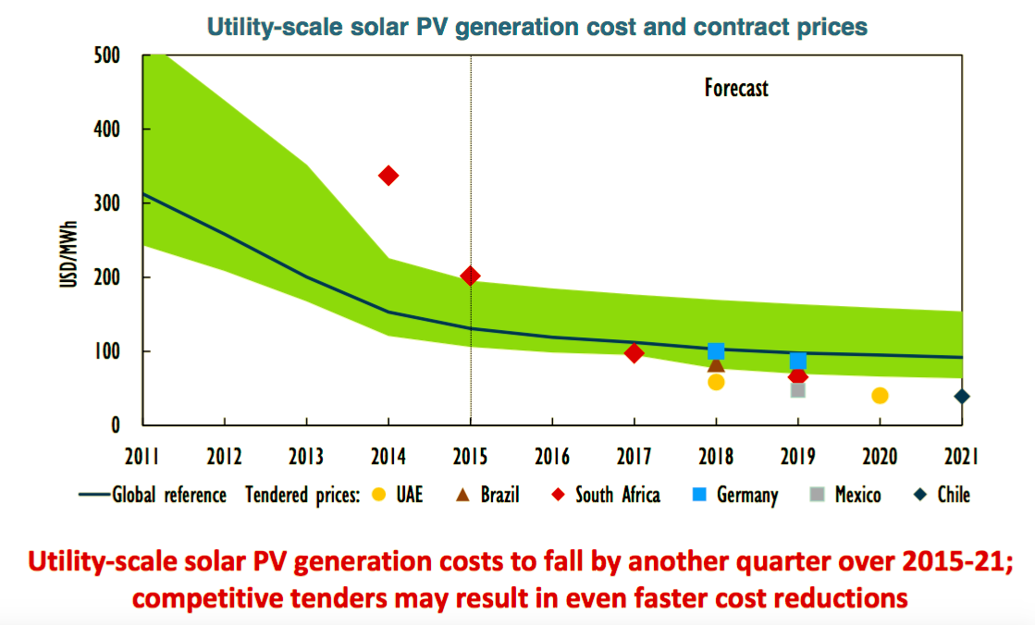
1.1 IEA
IEA continues to underestimate deflation in RE.
Notes:
China Shenhua Energy Co.’s Chairman last week reported:
“The pace of adjustments to the global energy structure in the short run will speed up and the trend of lowering the consuming proportion of fossil fuel energy will be obvious … the structural adjustments to the coal and electricity sectors will accelerate.”
That doesn’t sound like the largest coal company by value in the world has much doubt!

Slide 6
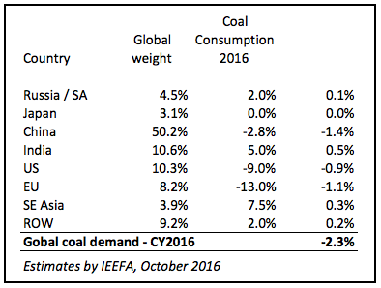
1.2 A long cyclical downturn or structural decline?
World coal peaked in 2013, down -0.6% yoy in 2014 and -2.8% yoy in 2015.
Notes:
China Shenhua Energy Co.’s Chairman last week reported:
“The pace of adjustments to the global energy structure in the short run will speed up and the trend of lowering the consuming proportion of fossil fuel energy will be obvious … the structural adjustments to the coal and electricity sectors will accelerate.”
That doesn’t sound like the largest coal company by value in the world has much doubt!

Slide 7
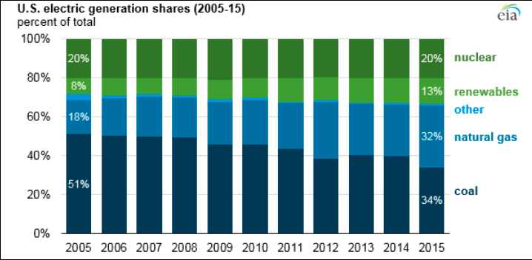
1.3 US Electricity Transformation
EIA Oct 2016: estimates coal share @ 30% for 2016

Slide 8
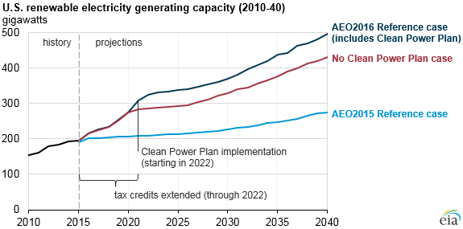
1.3 US Electricity Transformation
Source: http://www.eia.gov/todayinenergy/detail.cfm?id=26492&src=email
US EIA, June2016

Slide 9
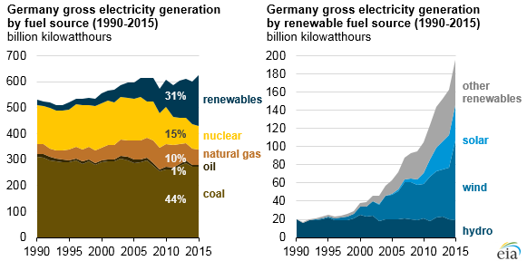
1.4 German Electricity Transformation
Energiewende: renewable sources hit 35.5% share in YTD Oct’2016 to increase to 40-45% by 2025 and to >80% by 2050

Slide 10
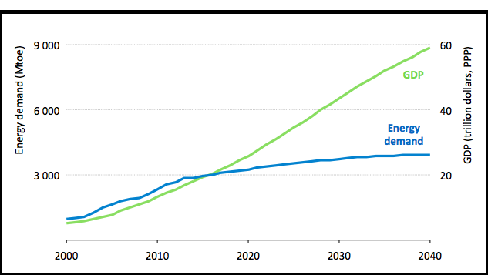
2.1 China - Energy Demand: IEA
Along with energy efficiency, structural shifts in China’s economy favouring expansion of services, mean less energy is required to generate economic growth. But the 2014-2016 coal decline suggests the IEA is still underestimating this trend. China reported 5.2% yoy decline in energy intensity in 1-3Q2016

Slide 11
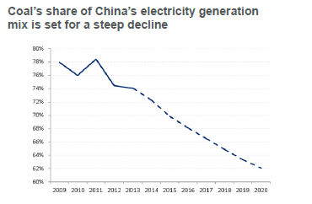
2.2 China’s Electricity Sector Transformation
YTD to Aug 2016:
China GDP +6.7% *
Electricity +3.0%
Thermal kWh -0.5%
Coal produced -10.5% *
Coal imports +15.2% *
Energy to GDP ratio -5.2% *
* Data year-to-Sept’16
Year to Dec 2015:
China GDP +6.9%
Electricity +0.5%
Coal consumption -4%
Coal imports -30%
China added 31GW new wind in 2015; 22GW of solar in 1HCY2016
Source: Citi Commodities, Tony Yuen, June 2014; “Energy Markets in Transformation”
http://uk.reuters.com/article/2015/07/15/china-economy-output-coal-idUKL4N0ZV1FX20150715
Notes:
This is becoming a more accepted central scenario with the world’s leading investment banks and commodity forecasters. Here is Citigroup’s forecast.

Slide 12
3.1 India
India’s Energy Minister Goyal stated November 2014:
A plan to transform the entire Indian electricity system with 225GW of renewable energy installs by 2022, and 350GW by 2030 vs 85GW in mid-2016. This involves a doubling of wind installs to 6GW pa and lifting solar installs tenfold to 10GW pa. In 2016, new solar costs fell 40% to US$65/MWh vs 2014 to now be cheaper than new imported coal fired power generation.
A plan for a US$50bn national grid upgrade to drive grid efficiency.
Plans to more than double India’s domestic coal production to 1.5Bn tpa by 2021, requiring a massive investment in rail infrastructure, coal handling and preparation plants plus major new mine development. The government is backtracking on this due to excessive success – record high stockpiles!

Slide 13
3.2 India
After the 6% yoy decline 2015/16 imports, and in announcing his target for a further 20% cut in 2016/17 to 160Mt of coal imports, Energy Minister Piyush Goyal stated rather categorically:
“Indian companies used to import a lot of thermal coal. We want to completely stop its import over the next 2-3 years. We have already reduced imports by Rs280bn. We will save Rs400bn."
http://www.businesstoday.in/current/policy/govt-considering-thermal-coal-import-in-two-three-years/story/231166.html
Notes:
China State Grid Corporation’s Chairman recently said the only hurdle to be overcome is “mindset”. “There is no technical challenge at all” to incorporating ever more renewable energy.
So any excuses Australian media and politicians give that the grid cant handle ever more RE are just that, excuses. No facts to support this erroneous assertion!

Slide 14
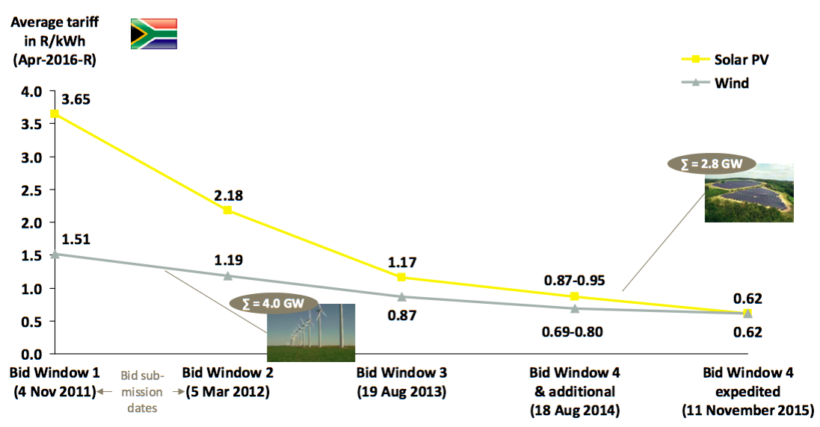
4.1 South Africa Electricity Transformation
Wind and solar at Rs.62/kWh US$44/MWh) is 40% cheaper than new coal at Rs.90/kWh when grid connectivity & inflation included.
Source: South African Department of Energy IPP Office’s publications on results of first four bidding windows http://www.energy.gov.za/IPP/List-of-IPP-Preferred-Bidders-Window-three- 04Nov2013.pdf ; http://www.energy.gov.za/IPP/Renewables_IPP_ProcurementProgram_WindowTwoAnnouncement_21May2012.pptx ; http://www.ipprenewables.co.za/gong/widget/file/download/id/279 ; IPP Office on Bid Window 4 expedited; StatsSA on CPI; CSIR analysis

Slide 15
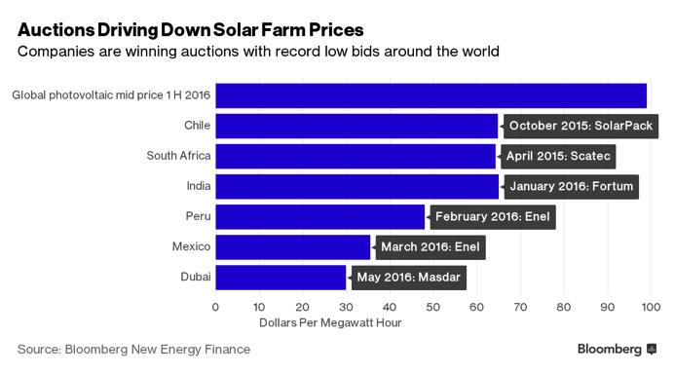
4.2 Renewable cost reductions
Since BNEF did this slide in June 2016:
Argentina Aug 2016 US$60-75/MWh
South Africa Oct’2016 US$44/MWh
UAE Sept 2016 US$24/MWh
Chile Oct 2016 US$50/MWh
http://www.bloomberg.com/news/articles/2016-06-16/solar-s-latest-subsidy-is-squeezing-down-costs-and-companies

Slide 16
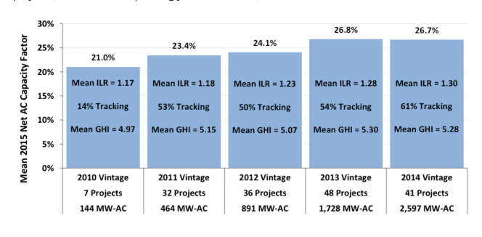
4.3 Renewable Energy is deflationary
Source: LBNL Aug 2016 http://newscenter.lbl.gov/2016/08/24/median-installed-price-solar-united-states-fell-5-12-2015/
Notes:
Renewables have seen massive technology innovation which has combined with massive economies of scale to drive costs down, to the point where grid-parity on an apples vs apples basis is now a real and immediate threat to incumbent fossil fuel companies.

Slide 17
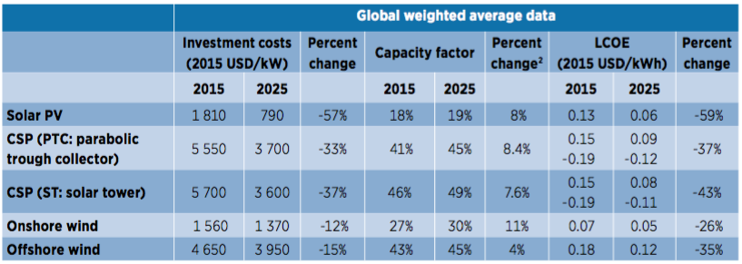
4.4 Global Average RE Cost Reductions
Source: International Renewable Energy Agency, June 2016
http://www.bloomberg.com/news/articles/2016-06-15/cost-of-clean-energy-to-keep-nosediving-into-next-decade
Notes:
Renewables have seen massive technology innovation which has combined with massive economies of scale to drive costs down, to the point where grid-parity on an apples vs apples basis is now a real and immediate threat to incumbent fossil fuel companies.

Slide 18
4.5 A long cyclical downturn or structural decline?
China State Grid’s Chairman in February 2016 stated:
The only hurdle to overcome is "mindset," Liu said. "There's no technical challenge at all."
http://www.eenews.net/energywire/2016/02/26/stories/1060033055
Notes:
China State Grid Corporation’s Chairman recently said the only hurdle to be overcome is “mindset”. “There is no technical challenge at all” to incorporating ever more renewable energy.
So any excuses Australian media and politicians give that the grid cant handle ever more RE are just that, excuses. No facts to support this erroneous assertion!

Slide 19
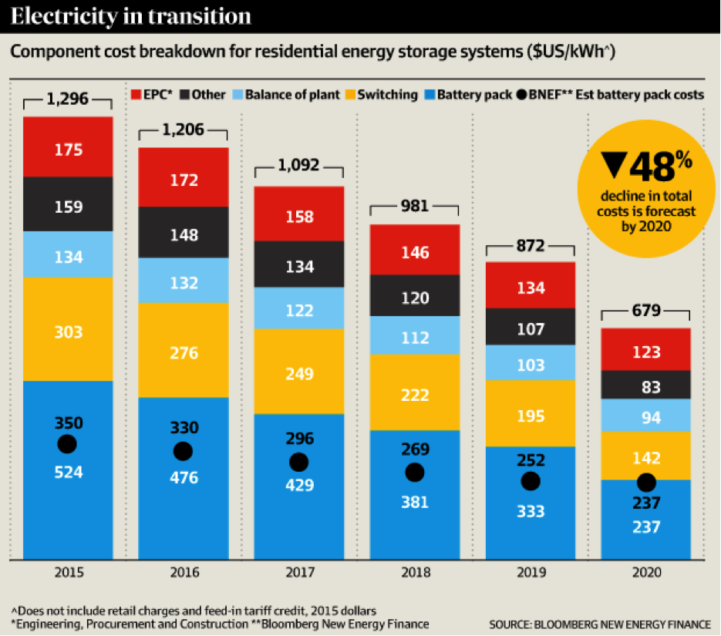
4.5 Storage is coming, rapidly
Notes:
Renewables have seen massive technology innovation which has combined with massive economies of scale to drive costs down, to the point where grid-parity on an apples vs apples basis is now a real and immediate threat to incumbent fossil fuel companies.

Slide 20
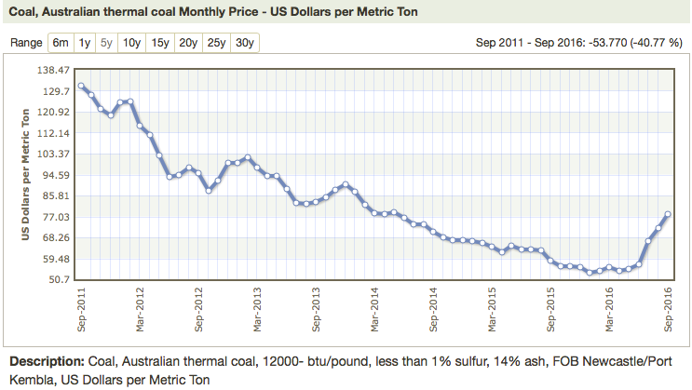
5.1 Thermal Coal Export Price Collapse
Newcastle Export 6,000kcal Thermal US$/t – Down 50%; but recent upturn – sustainable?
The spot price in Oct’2016 is US$90-100/t and 2022 forward price is US$69/t

Slide 21
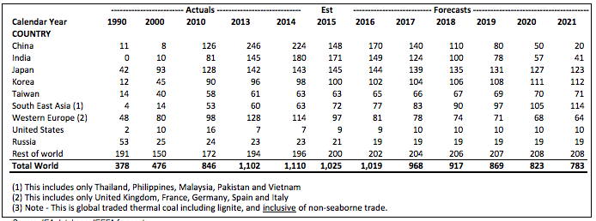
5.2 International Thermal Coal – Key Markets
A 30% decline in global demand

Slide 22
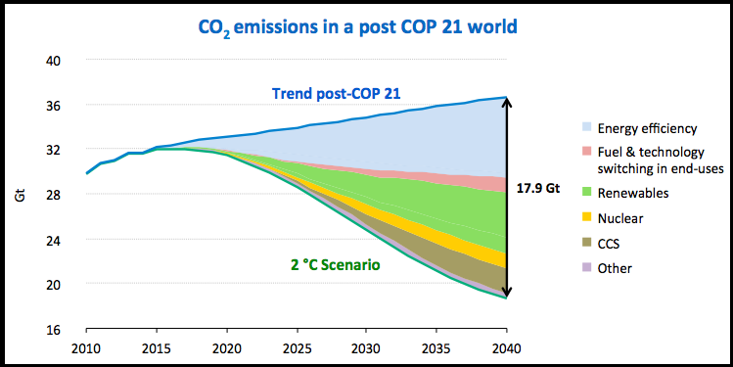
6.1 A 2 °C pathway requires more technological innovation, investment & policy ambition
Massive additional investments in efficiency, renewables, nuclear power and other low carbon technologies are required to reach a 2 °C pathway – if COP21 implemented the IEA New Policies Scenario is not valid.

Slide 23
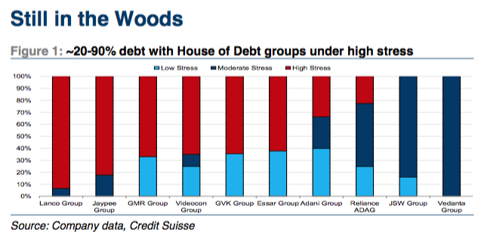
7.1 Stranded Assets – Indian Australian coal
GVK, Lanco and Adani all show financial distress
Notes:
Renewables have seen massive technology innovation which has combined with massive economies of scale to drive costs down, to the point where grid-parity on an apples vs apples basis is now a real and immediate threat to incumbent fossil fuel companies.

Slide 24
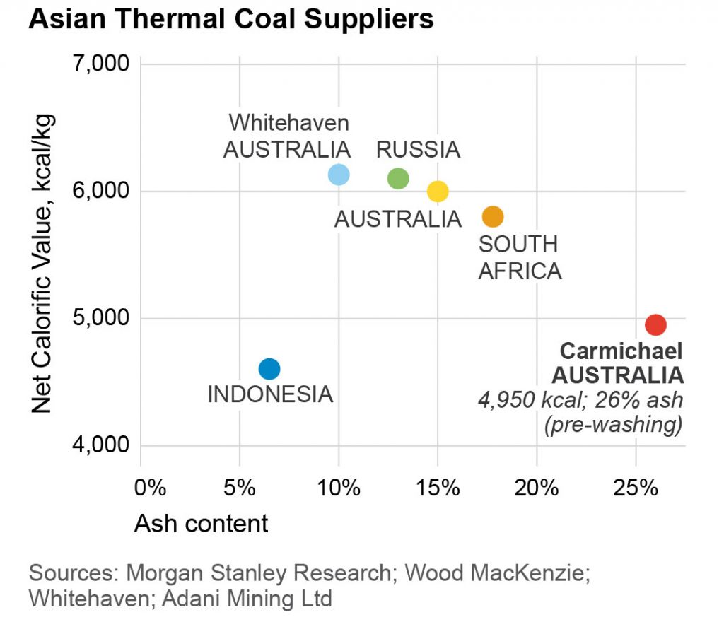
7.2 Carmichael Coal Quality

Slide 25
7.3 Adani Enterprises Ltd
Coal mining: India (targeting 31Mtpa) & Indonesia (6Mtpa), coal trading, gas distribution & solar (51% Adani Green Energy)
Owner of Adani Mining Australia Pty Ltd: shareholders funds
–A$227m, net debt A$1.42bn
Market cap: US$1.1bn
Net debt: US$2.6bn
ROE: 5.1% (2015: 6.9%)
Estimated net debt of
Adani Group US$15.2bn

Slide 26
DISCLAIMER
The Institute for Energy Economics and Financial Analysis (IEEFA) is a not-for-profit research Institution organized under Internal Revenue Code 501(c)(3) of the United States.
The authors of this presentation are not brokers, dealers or registered investment advisors and do not attempt or intend to influence the purchase or sale of any security.
This presentation is intended for informational and educational purposes only. This presentation is not a solicitation, an offer, a recommendation to buy, hold, or sell any securities, products, service, investment or participate in any particular trading scheme in any jurisdiction. The presentation is not and shall not be used as part of any prospectus, offering memorandum or other disclosure attributable to any issuer of securities. No individual or entity is authorized to use the information contained herein for the purpose or with the effect of incorporating any such information into any disclosure intended for any investor or potential investor. This presentation is not intended, in part or in whole, as financial advice.
The information and opinions in the presentation constitute a judgment as at the date of the presentation and are subject to change without notice. The information and opinions contained have been compiled or arrived at from sources believed to be reliable and in good faith, but the authors do not represent and make no warranty, express or implied, as to the accuracy, completeness or correctness contained in this presentation. The authors do not warrant that the information is up to date. All information provided expressly disclaims any and all warranties, express or implied, including without limitation warranties of satisfactory quality and fitness for a particular purpose with respect to the information contained herein.
All information contained herein is protected by law, including but not limited to Copyright Law, and none of the information contained herein is to be copied or otherwise reproduced, repackaged further transmitted, transferred, or redistributed for subsequent use for any such purpose in whole or in part, in any form or manner or by any means whatsoever, by any person without prior written consent from the authors.
JURISDICTION
The authors do not make any representations that the use of information contained herein is appropriate for use in other locations or that may access this information from outside of the United States.
This document is not directed to, or intended for distribution to or use by, any person or entity who is a citizen or resident of or located in any locality, state country or other jurisdiction where such distribution, publication, availability or use would be contrary to law or regulation or would subject the Institute to any registration or licensing agreement within such jurisdiction.
Notes:
The global equity market are increasingly pricing in the risk that seaborne thermal coal market as having entered structural decline. Most global coal companies have seen their equity capitalisation slashed by 70-90% over the last four years be it in America, Australia or HK – refer charts over the next three pages.
In part, this reflects the usual short sighted corporate stupidity of expanding aggressively when coal prices are at their peak. Most Western Coal companies undertook expensive M&A at the top as well, leaving most in financial distress now.

