Slide 1
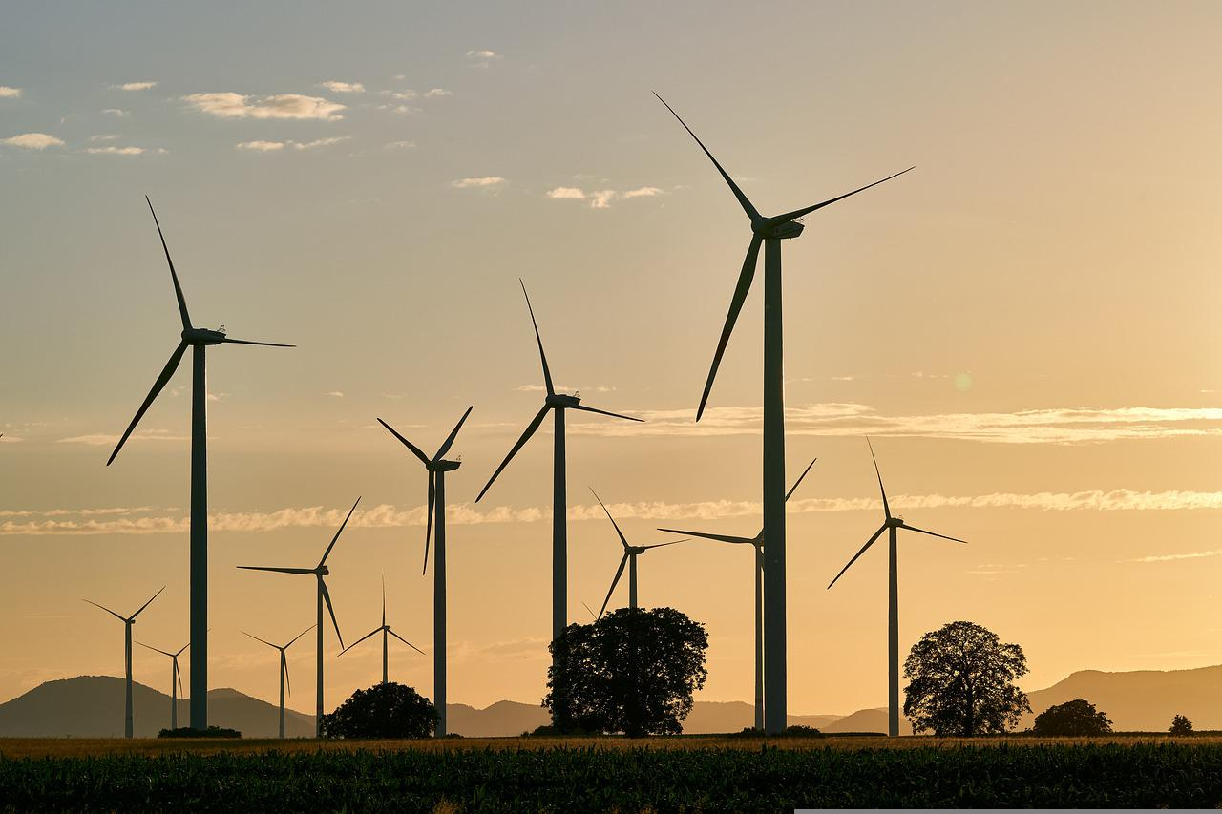

What’s Happening in Asia?
Will the boom in new North American supply stimulate demand in Asia?
Sam Reynolds
February 18, 2026

Slide 2
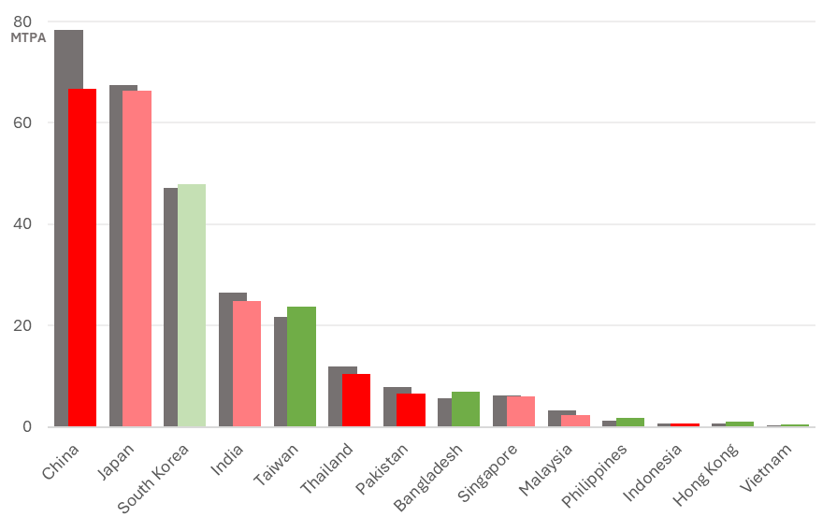
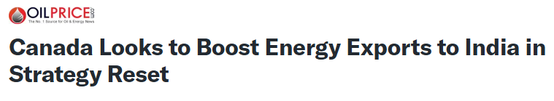

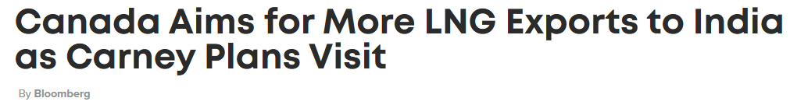
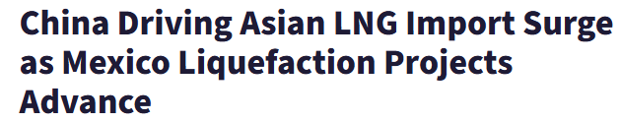
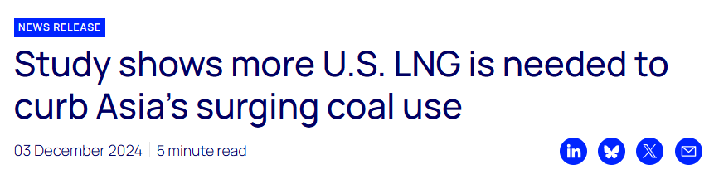
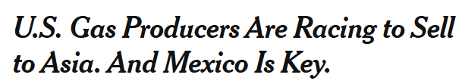
Asia’s LNG demand in 2025
Overall, Asia’s LNG demand fell 5%.
Mixed picture from Japan, Korea, and Taiwan. Nuclear and RE are expected to hinder long-term growth in Japan and South Korea.
Declines among the largest buyers in price-sensitive South and Southeast Asian markets.
Can China and India underpin long-term Asian demand growth?

Slide 3
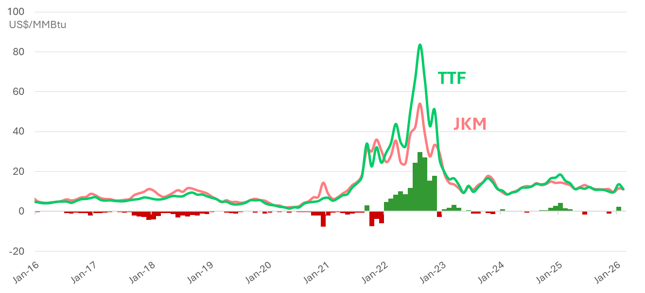
Spot cargoes are still chasing TTF
Average prices in Asia have fallen from $13.7/MMBtu in 2023 to $12 in 2025.

Slide 4
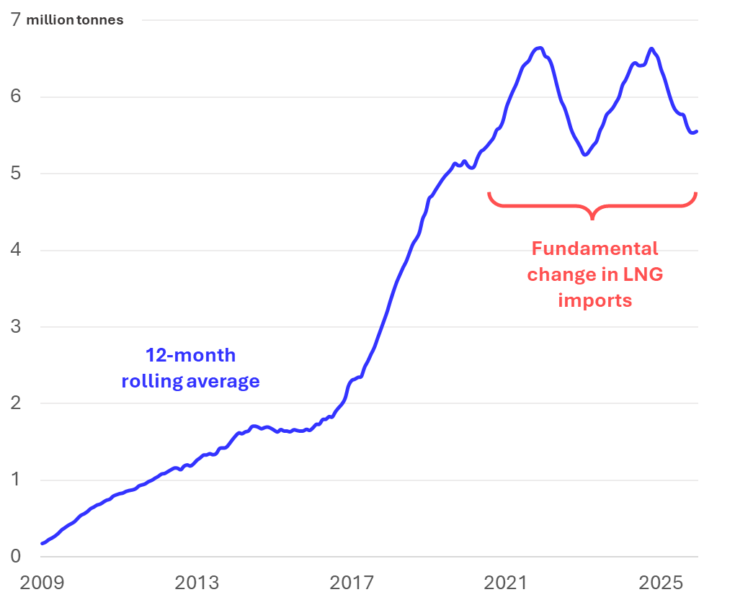

China: The elephant in the room
What’s changed over the last four years?
US-China LNG relationship amidst extreme market volatility.
Economics and energy security favor rapid domestic production growth and pipeline imports.
Unprecedented renewables expansion, on pace for 2,461GW of renewables by 2030.
Battery electric trucks are eating into the market share of LNG-fired trucks.

Slide 5
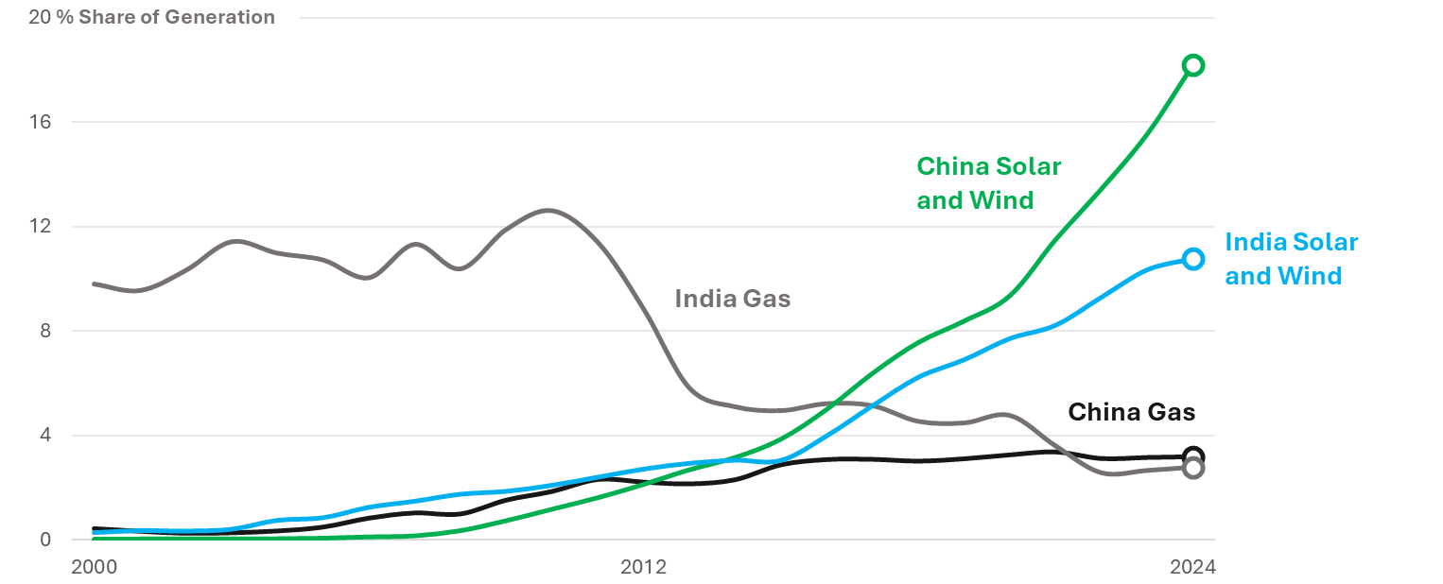
Renewables are limiting the role of gas

Slide 6
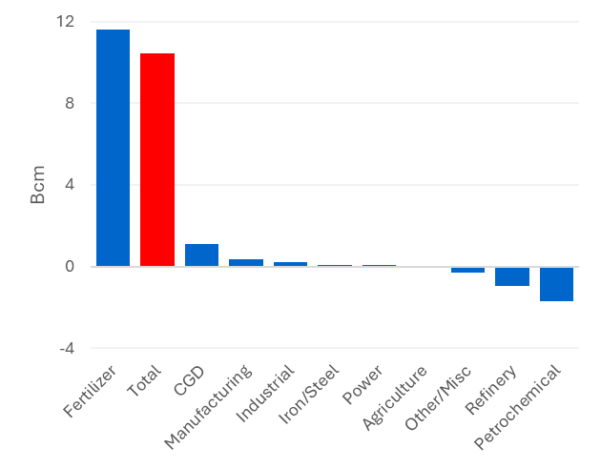
India: Price is the bottom line
Change in LNG demand by sector, FY2016-24
India’s fertilizer sector has accounted for nearly all of LNG demand growth.
India has built almost no new gas-fired power capacity since 2016 and does not plan to build any new plants through 2032. Why?
Stranded asset risk. 31 gas-fired power plants did not generate any electricity at all in FY2025.
8GW of total stranded asset capacity, with an estimated value of US$8.5 billion.
High gas costs. LNG would have to fall below US$6/MMBtu to compete with coal and RE.

Slide 7
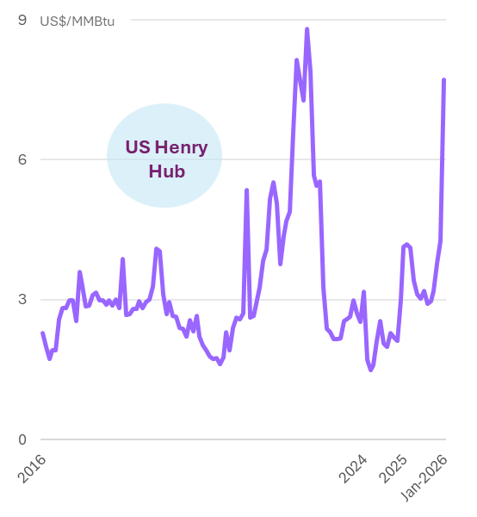
Questions for North American LNG
Amidst an incoming global oversupply of LNG, will US LNG get cheaper, too?
Will infrastructure limitations and rising construction costs hinder the economics of projects in western Canada and Mexico?
Will North American projects be able to compete with abundant, low-cost Qatari LNG?
How quickly is the demand window in key Asian markets closing (e.g., China’s trucking sector, India’s power market)?

Slide 8
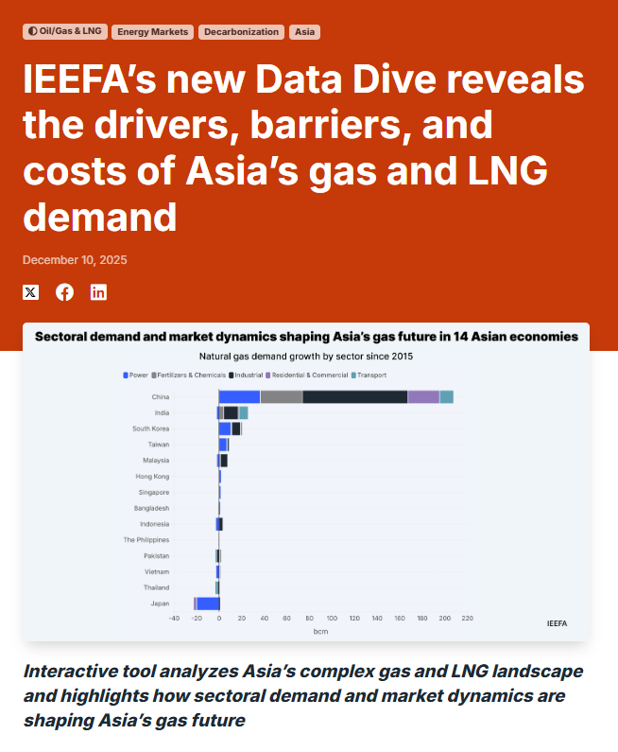


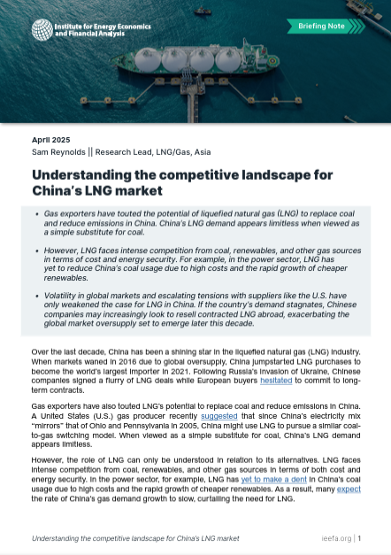
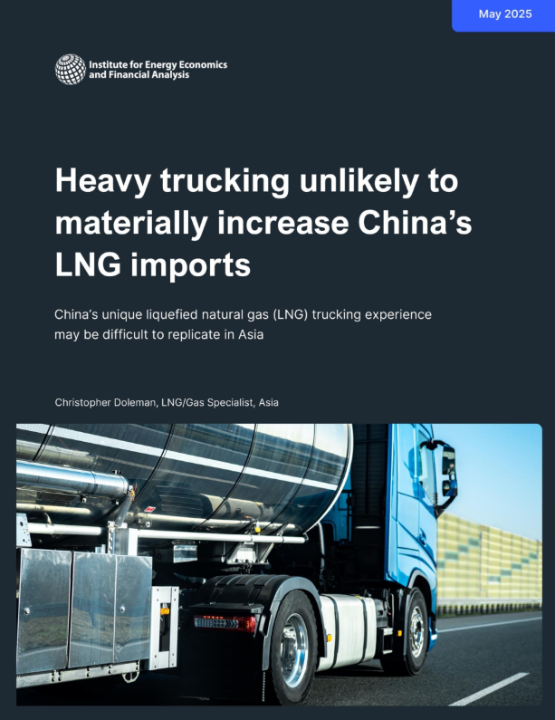
Recent and upcoming IEEFA Asia reports

Slide 9

Thank You
Contact
Sam Reynolds
sreynolds@ieefa.org

