Slide 1


Bottlenecks to Renewable Energy Integration in South Korea
Asian Investor Group on Climate Change (AIGCC) Webinar
Michelle Kim, Energy Finance Specialist, South Korea at IEEFA
October 27, 2025

Slide 2
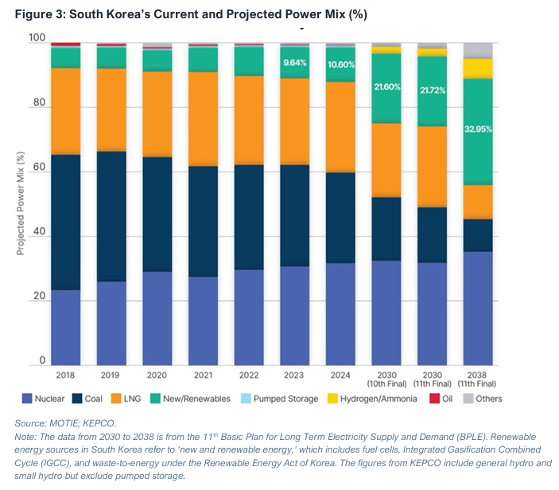
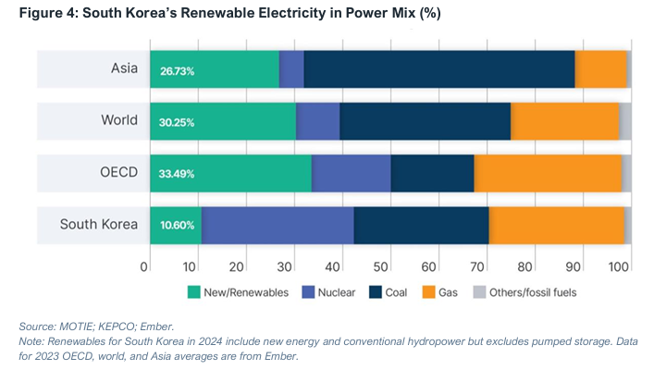
South Korea’s renewable energy transition lags at least 15 years behind

Slide 3
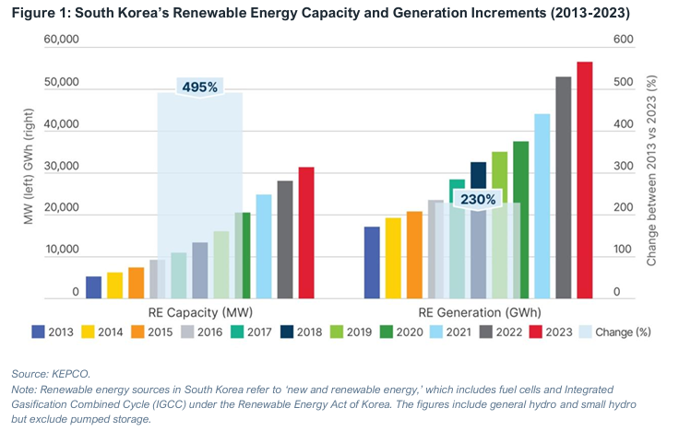
While RE Capacity increases 6-fold, RE generation rises only 3-fold

Slide 4
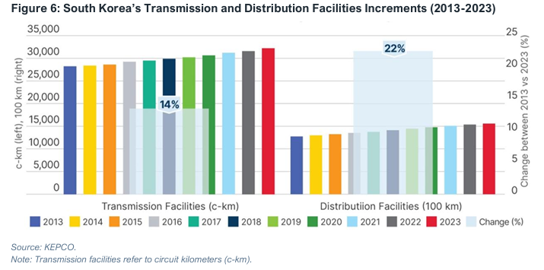
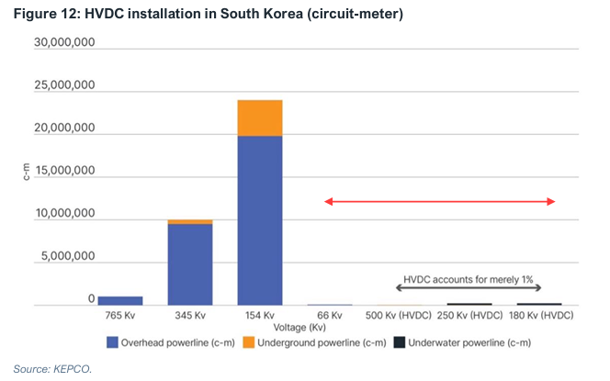
Bottleneck 1 : Inadequate Grid Expansion & Modernization
①Inadequte Grid Expansion & Modernization

Slide 5
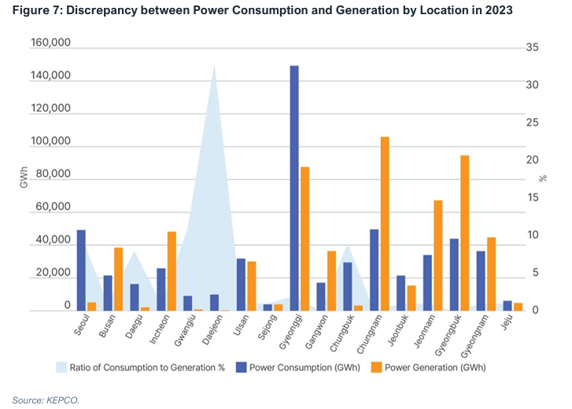
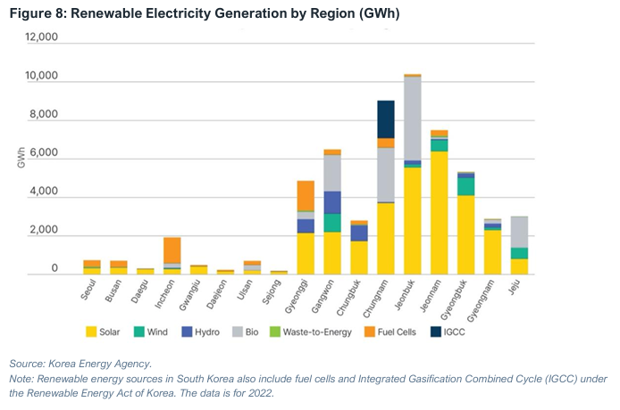
Bottleneck 1-1: Not In My Back Yard (NIMBY)
①Inadequte Grid Expansion & Modernization

Slide 6
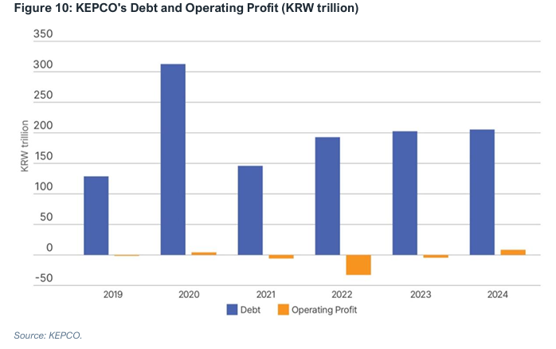
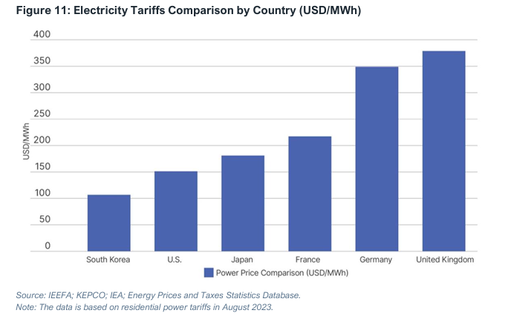
Bottleneck 1-1: Uncompetitive Power Market Structure
①Inadequte Grid Expansion & Modernization

Slide 7
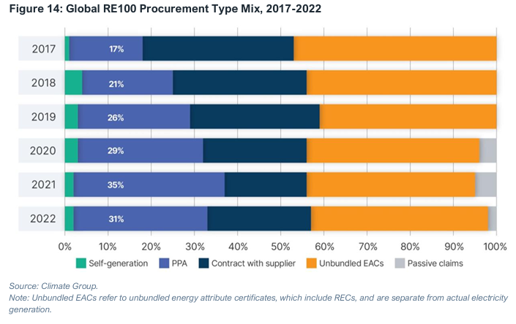
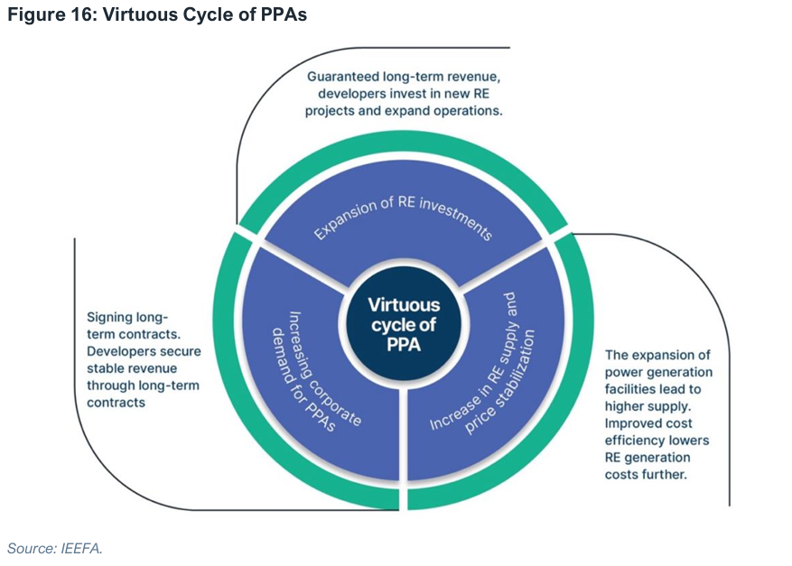
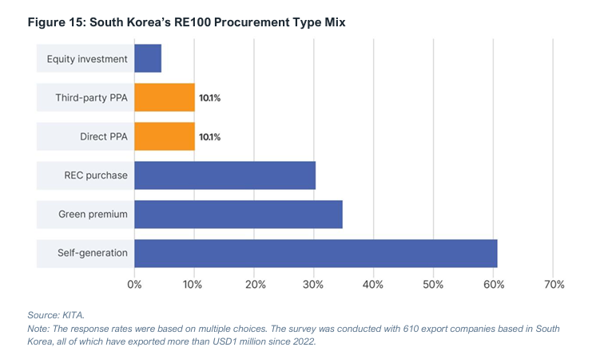
Bottleneck 2: Ineffective Power Purchase Agreement (PPA)
②Ineffective Power Purchase Agreement

Slide 8
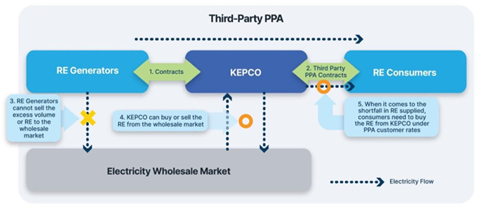
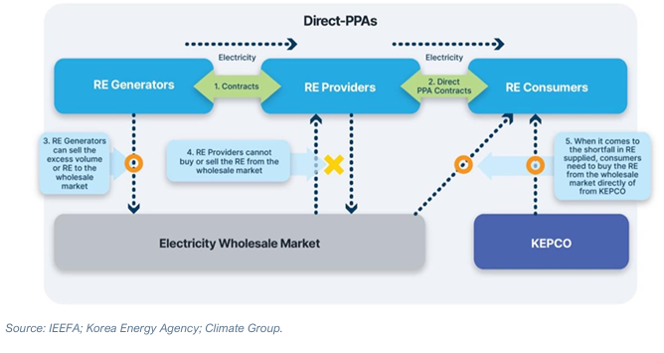
Bottleneck 2-1: Rigid and Complex PPA systems
②Ineffective Power Purchase Agreement

Slide 9
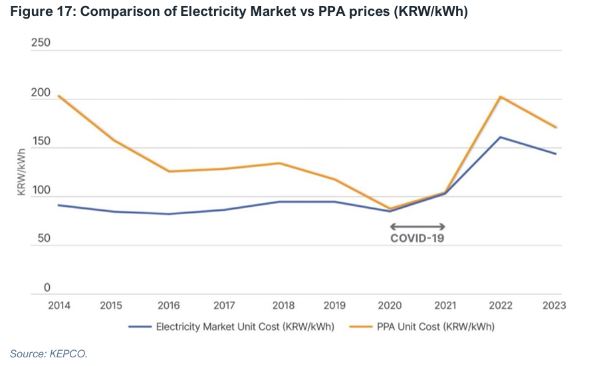
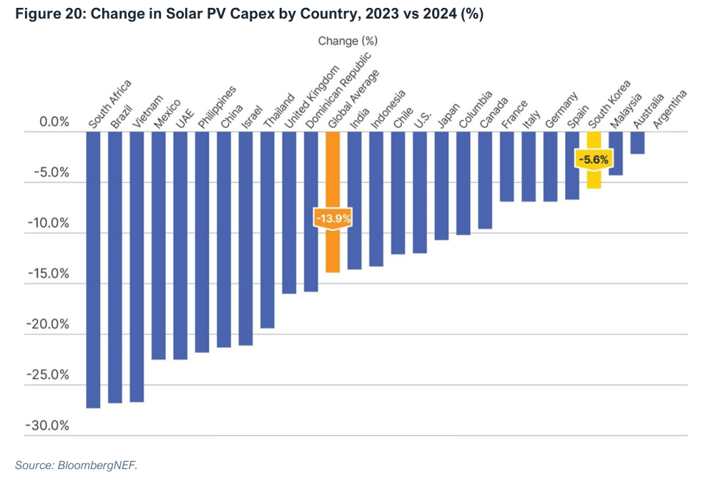
Bottleneck 2-2: High PPA Prices
②Ineffective Power Purchase Agreement

Slide 10
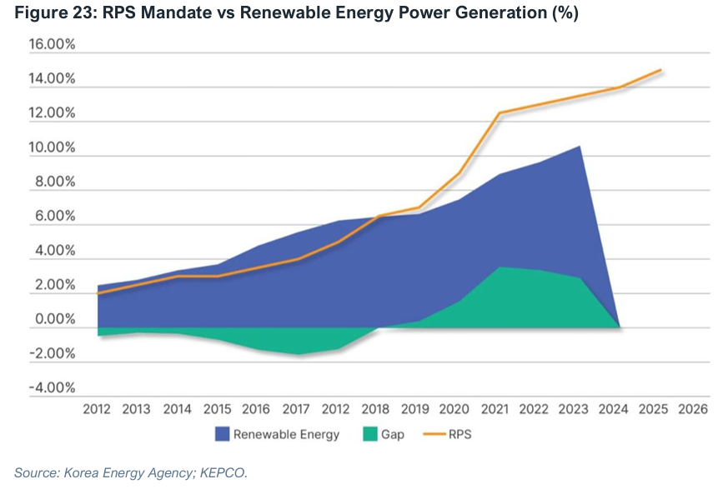
Bottleneck 3: Inefficient Renewable Portfolio Standard (RPS)
③Inefficient RPS

Slide 11
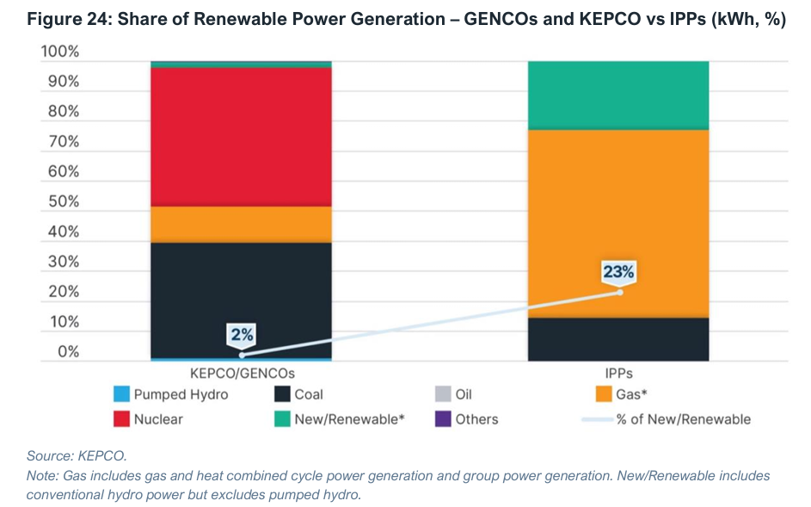
Bottleneck 3-1: Lack of RE generation
③Inefficient RPS

Slide 12
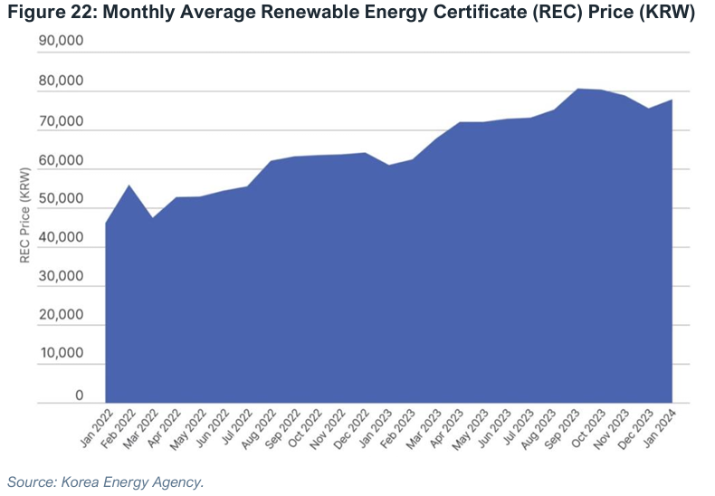
Bottleneck 3-2: Overreliance on REC leads to high REC burdens
③Inefficient RPS

Slide 13
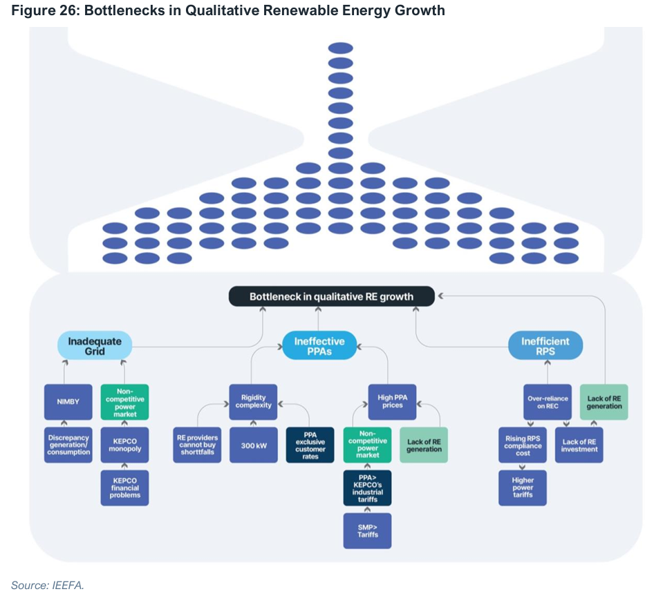
Summary: What should be done to address RE bottlenecks?

Slide 14
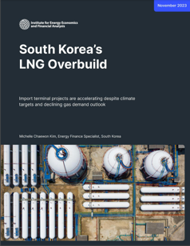
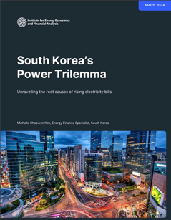
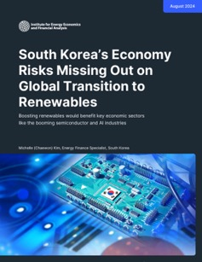
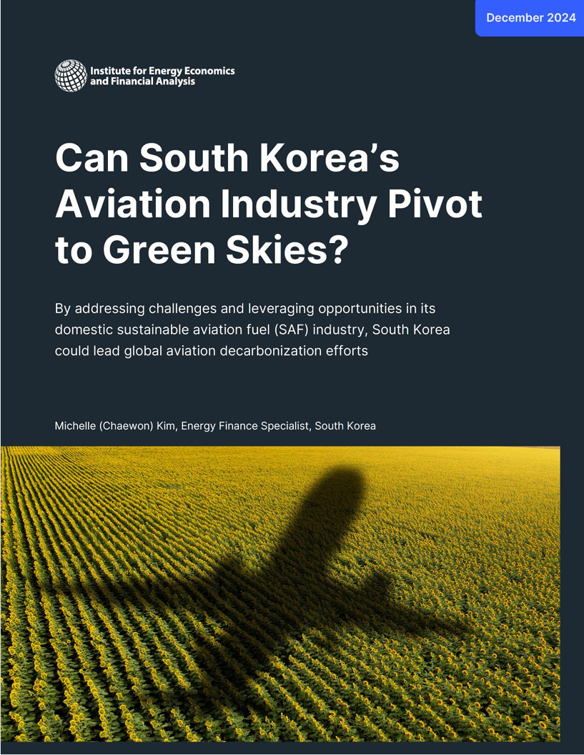
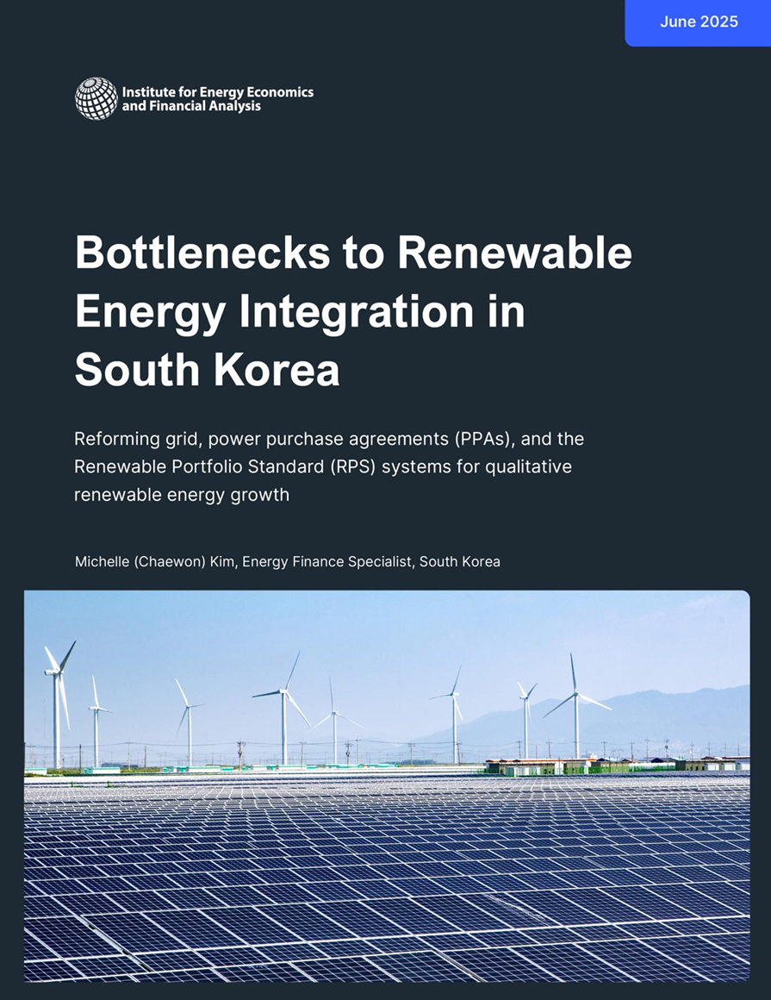
Thank you very much.
More details of the presentation can be found in IEEFA’s South Korea report series.
Michelle (Chaewon) Kim
ieefa.org
mkim@ieefa.org

