Slide 1
U.S. LNG Exports in the Wake
of the Ukraine Invasion
Clark Williams-Derry
May 19, 2022

Slide 2
Where U.S. Natural Gas Goes
The U.S. now exports one-fifth of its gas, mostly as LNG.
In 2016 the US had no LNG export terminals. Now there are 7, with one more coming online in 2024.
LNG
*Includes transportation
Source: U.S. Energy Information Administration.

Slide 3
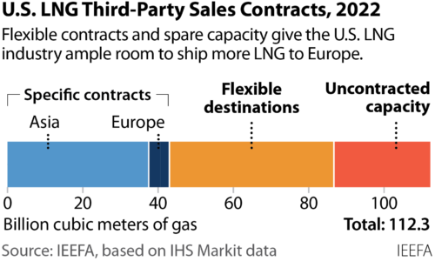
The U.S. offers flexibility in where LNG is shipped.
Even Asian buyers are now shipping some LNG to Europe.
Source: IEEFA, based on IHS Markit data.

Slide 4
U.S. LNG Shipments to EU + UK
U.S. LNG shipments to Europe will likely rise by about 50 bcm this year.
More U.S. LNG is going to Europe, and less is going to Asia and the Americas.
Source: IEEFA estimates, based on IHS Markit data.

Slide 5
Illustrative LNG Export Economics, U.S. Gulf to U.K.
Prices, not politics, are directing traffic.
High prices boosted profits for shipping U.S. LNG to Europe.
UK gas price: $9.10
Source: IEEFA estimates, based on U.S. EIA and IHS Markit data.

Slide 6
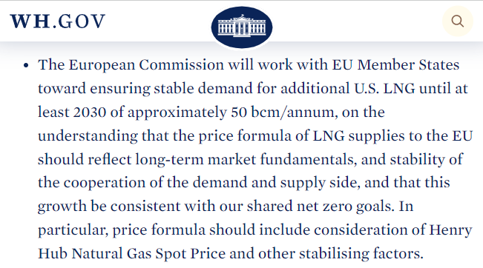
EU-White House targets: weaker than what the market was already doing.
But note: the EU wants a price break.

Slide 7
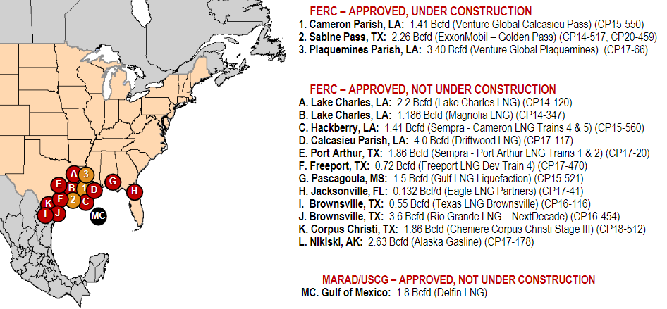
A lack of investors, not a lack of permits, has held up new LNG terminals.
Source: Federal Energy Regulatory Commission.

Slide 8
U.S.-Sourced LNG Agreements Since Feb. 24
New U.S. LNG agreements are mostly being signed with global traders and Asian utilities, not European buyers.
DATE | PROJECT | BUYER | MTPA
7-Mar | Plaquemines LNG | Shell | 2
16-Mar | Plaquemines LNG | New Fortress Energy | 1
16-Mar | Calcasieu Pass 2 | New Fortress Energy | 1
24-Mar | Rio Grande LNG | Guangdong Energy | 1.5
29-Mar | Lake Charles LNG | ENN NG | 1.8
30-Mar | Lake Charles LNG | ENN Energy | 0.9
31-Mar | Mexico Pacific Ltd. | Guangzhou Development Group | 2
4-Apr | Cameron LNG Phase 2 | TotalEnergies/Mitsui/Mitsubishi/NYK | 6.75
6-Apr | Rio Grande LNG | ENN | 1.5
2-May | Rio Grande LNG | Engie | 1.75
2-May | Lake Charles LNG | Gunvor Group | 2
3-May | Lake Charles LNG | SK Gas | 0.4
10-May | Plaquemines LNG | ExxonMobil LNG Asia Pacific (EMLAP) | 1
10-May | Calcasieu Pass 2 | ExxonMobil LNG Asia Pacific (EMLAP) | 1
11-May | Plaquemines LNG | Petronas | 1
16-May | Cameron LNG Phase 2 | PGNiG | 2
16-May | Port Arthur | PGNiG | 1
Source: Company press releases, news reports

Slide 9
Henry Hub Prices, First Week of May ($USD/MMBtu)
Rising exports and weak production growth—along with a cold spring—have pushed U.S. gas prices to multi-year highs.
If sustained, high prices could erode U.S. LNG export profits.
Source: IEEFA estimates, based on U.S. EIA and IHS Markit data.

Slide 10
U.S. LNG Recap
U.S. LNG shipments to Europe have boomed during the Ukraine crisis. Prices, not politics, directed LNG traffic.
The U.S. will likely meet this year’s “target”—15 additional bcm of gas to the EU—by July or August. For 2022, +50 bcm is within reach.
Europe has asked for cheaper U.S. LNG, not just a supply boost.
Growing exports have linked domestic gas markets to global volatility.
U.S. LNG Exports in the Wake of the Ukraine Invasion

Slide 11
Closing Thoughts…
The Ukraine crisis has boosted global LNG prices and increased volatility.
In Asia, high LNG prices and unreliable supplies are weakening demand growth. In some cases, that may be permanent.
Europe has lots of gas infrastructure…but some of it is in the wrong place—in part because infrastructure planning was left to vested interests.
Even though E.U. LNG demand is rising, total gas demand is poised to fall.
The U.S. is exporting lots of LNG…and importing high gas prices as a result.
U.S. LNG Exports in the Wake of the Ukraine Invasion

Slide 12
Sam Reynolds
sreynolds@ieefa.org
Arjun Flora
aflora@ieefa.org
Ana María Jaller-Makarewicz
ajallermakarewicz@ieefa.org
Clark Williams-Derry
cwilliamsderry@ieefa.org
U.S. LNG Exports in the Wake of the Ukraine Invasion

