Slide 1
ESB Capacity Mechanism Proposal and other options
Johanna Bowyer | June 2022

Slide 2
Capacity mechanism and other options
Capacity mechanism proposal is to set up a new mechanism to pay generators based on availability in periods where the system is “at risk”
It proposed to include payments to all forms of generation capacity
However it will not solve the current problems facing the National Energy Market – as it will not provide certainty around coal exits and may lock in high emissions system for longer while discouraging new entrants
It is also likely to have high cost to consumers, at a time when electricity prices are high
Energy Ministers and the Industry should explore other proposals to manage exit of coal generators and entry of new low emissions capacity

Slide 3
Defining the at risk period & how capacity is de-rated based on availability in at risk period
Target Capacity = De-rated Capacity of Participating Existing Providers +/- Reliability Gap/surplus
At risk period
De-rating
At risk period defined to understand how to “de-rate” capacity based on availability in this at risk period
Options posed for defining at risk period:
Focus on high demand period & evolve over time (e.g. start with summer peak, move to winter peak as system evolves)
Create 2 or more at-risk periods (e.g. summer and winter peaks)
Focus on event driven at risk periods (use a model to forecast events)
Note: disconnect could occur if at-risk period definition is different from compliance checks (e.g. if payment is based on LOR2 and LOR3 availability but derating is not)
Capacity provider’s nameplate capacity is scaled down to the level of expected output over “at risk periods”
De-rating enables each MW of capacity across the system to be considered interchangeably
Options posed for derating:
Availability in predefined at risk period – determined by a forecast using a simulation, or based on historical data
Events based definition – forward looking simulation to determine contribution to meeting reliability standard in a given event
Hybrid of above – e.g. first for some technologies, second for others
Source: ESB Capacity Mechanism High-level Design Paper June 2022

Slide 4
ESB capacity mechanism proposal – IEEFA’s understanding of current preferred model
T-4
T-1
T ‘DELIVERY YEAR’
AFTERWARDS
Australian Energy Market Operator (AEMO) forecast req capacity by region in the at-risk period
Target Capacity = De-rated Capacity of Participating Existing Providers +/- Reliability Gap/surplus
Re-forecast demand
CHECK IF:
“Nonperformance will result in the loss of capacity revenue but not directly result in the subsequent risk of the Australian Energy Regulator pursuing civil penalties on this basis.” – Energy Security Board
1. De-rated capacity was available over delivery year*
2. Generators bid available in actual LOR2 & LOR3 events*
If yes, AEMO pays generator at through the year
If yes, AEMO pays generator at the end of the year
Auction 1
AEMO runs auction for capacity and awards contracts
Auction 2 (true-up)
Take into account any changes that have occurred since the first auction
Retailers + large energy users pay AEMO for their required capacity (could be based on actual demand-TBD)
Areas open for consultation/further design:
Auction price settings– including whether multiple price bands may be considered
When first auction should be: T-3, T-4 or earlier
ESB open to retailers being responsible for procuring some portion of capacity requirement
Areas open for consultation/further design:
Is second auction needed?
Retailers pass through cost to consumers
* Multiple options for performance obligations were provided by Energy Security Board – this option was proposed for consultation. Other options include payment based on forecast availability or exposure to spot prices above certain threshold.
Source: ESB Capacity Mechanism High-level Design Paper June 2022
LOR = Lack of Reserve

Slide 5
Key points from the proposal
Interaction with energy market settings: “The Energy Security Board (ESB) will need to determine if the Market Price Cap should be lower than it would be in the absence of a capacity mechanism.”
Existing capacity: Allocate capacity certificates via auction for 1 delivery year at a time
New capacity: “The ESB considers that the preferred capacity mechanism should include longer-term support for new capacity entering the market for the first time”
All types of capacity included

Slide 6
The capacity mechanism proposal could lock in a legacy high emissions electricity system
Pays all types of generation – even if capacity payment not needed
A coal-inclusive capacity mechanism could keep ageing coal-fired generators in the system for longer
Does not provide certainty around coal exits
May deter new entrants as existing generators are paid so will stay in system longer than otherwise – could lead to underinvestment in new renewables and storage – leaving the National Energy Market more exposed to future unplanned coal outages
Mechanism is ill-suited in valuing flexibility
Mechanism likely to be high cost
VIC – no payment to fossil fuels

Slide 7
“
Introduction of a capacity mechanism has an asymmetric effect on the risk profile of different generation technologies, tilting the resource mix towards those with lower fixed costs and higher operating costs. One implication of this result is that current market structures may be ill-suited to financing low-carbon resources, the most scalable of which have high fixed costs and near-zero operating costs.”¹
1. Jacob Mays, David P. Morton & Richard P. O’Neill. Asymmetric risk and fuel neutrality in electricity capacity markets. 28 October 2019.

Slide 8
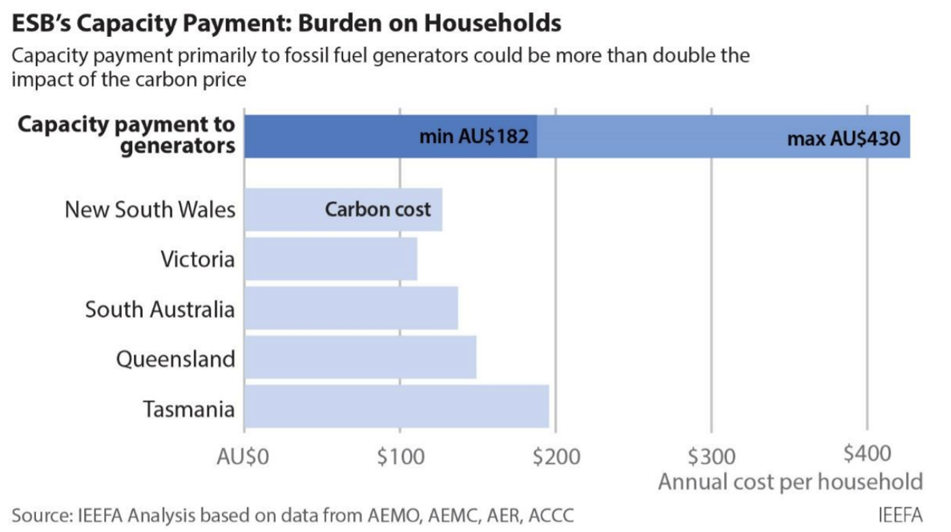
Cost to consumers could be high
Based on the WA capacity market:¹
$2.9 billion to $6.9 billion each year
$182 to $430 per household per year
Note thorough cost benefit analysis is needed
IEEFA. ESB Capacity Market: Burden on Households. August 2021.

Slide 9
“
The approach ultimately transfers risk to consumers. There is not a broad consensus in Australia that intervention on this scale is justified¹
1. FTI Consulting. RAMs in the NEM. A Report for the ESB. 16 July 2020. TI Consulting*

Slide 10
International example of capacity markets
Country | Existing / new entrants supported | Tech types excluded | Outcomes / Feedback
Poland | New + existing | Coal 2025 onwards (emissions) | “The results prove that the primary beneficiaries of the capacity market in Poland have been the existing units (including the refurbishing ones) responsible for more than 80% of capacity obligation volumes contracted for 2021–2025”¹ “The introduction of a capacity market delays the decarbonisation of the power system and has a negative impact on carbon neutrality. Even though coal-fired units are phased out, they are mainly replaced by natural gas.”²
UK | New + existing | Coal 2025 onwards (emissions) | “It has historically secured predominantly carbon intensive forms of generation, particularly unabated gas-fired generation. For example, about two thirds of capacity with agreements for Delivery Year 2024/25 are gas fuelled.”³ -UK Govt
PJM | New + existing |  | World’s largest centrally dispatched electricity grid The capacity mechanism is highly complex, with detailed regulations covering virtually every aspect of the scheme Rule changes & legal challenges are frequent in the PJM capacity mechanism Consistently over procured relative to target reserve margin⁴
Przemysław Kaszynski, Aleksandra Komorowska, Krzysztof Zamasz , Grzegorz Kinelski and Jacek Kaminski. Capacity Market and (the Lack of) New Investments: Evidence from Poland. 23 November 2021.
Aleksandra Komorowska. Can Decarbonisation and Capacity Market Go Together? The Case Study of Poland. 20 August 2021
The UK Department for Business, Energy and Industrial Strategy. Capacity Market: Improving delivery assurance and early action to align with net zero. July 2021.
PJM information from NERA Case Studies of International Capacity Markets prepared for the ESB

Slide 11
International examples of countries in midst of energy transition with no capacity market
Country | % Wind and solar | Other policy / information
Germany | 33% (2020) | Decided against capacity market in 2016 after consultation with experts & stakeholders¹
Denmark | 61% (2020) | Coal phase out by 2028 No capacity market
Alberta CA | 14% (2020) | Considered capacity market but decided against it after stakeholder input²
Pradyumna C Bhagwat, Laurens de Vries and Benjamin F. Hobbs. Expert Survey on capacity markets in the US: Lessons for the EU. 2016. And: Clean Energy Wire. Gas industry calls for capacity market debate as Germany exits nuclear and coal. 11 February 2020
https://www.alberta.ca/electricity-capacity-market.aspx

Slide 12
Many other options exist to deal with the challenges facing the National Energy Market
High levels of uncertainty around coal exits
Significant replacement resources required
Govt agreement to close down coal plants once new capacity built
Auction for closure (Jotzo model, Blueprint model)
Regulate closures through EPS (UK)
Strengthen notice period via a financial bond
Penalties / bond surrender in case of low reliability
Run an audit of generators to assess viability
Renewable Electricity Storage Target (REST)
Government underwriting e.g. NSW Roadmap
Short term relief for consumers
Reserves at the right level
Capacity reserve (out of market -> in market)
Operating reserve
Jurisdictional Strategic Reserve (JSR)
Tax LNG exporters or gas producers & direct funds to short term cash relief
Energy efficiency

Slide 13
Conclusion
The capacity payment is likely to be expensive and delay decarbonisation efforts
Energy Ministers and the Industry should explore other proposals instead, to:
Deliver certainty around coal exits
Incentivise new entrants

Slide 14
Thank you
jbowyer@ieefa.org

Slide 15
Appendix
0.1

Slide 16
Capacity market cost calculation
In the Western Australian electricity market, the capacity payment each year ranges from a low of $78,573/MW to a high of $186,001/MW. Such a payment to cover the NEM’s forecast 2022/23 1 in 2 year (POE50) peak in demand of 37,161MW (AEMO ESOO 2020) would entail capacity payments of between $2.9 billion and $6.9 billion per year.
The proportion of the $2.9-$6.9 billion capacity payment cost attributed to residential households is 40%, which is the mid-point of the estimated household contribution to peak demand according to the Australian Energy Market Commission 2012 Draft Report - Power of choice - giving consumers options in the way they use electricity, which stated, “various studies have shown that the residential contribution to peak demand can be as high as 35 per cent to 45 per cent on peak demand days”.
The number of residential customers is sourced from the Australian Energy Regulator Annual Retail Markets Report 2019-20 at 6,423,649.
Dividing the total cost of the residential portion of the capacity market by the number of residential houses results in an annual average cost per household on their power bill in the realm of $182 to $430

Slide 17
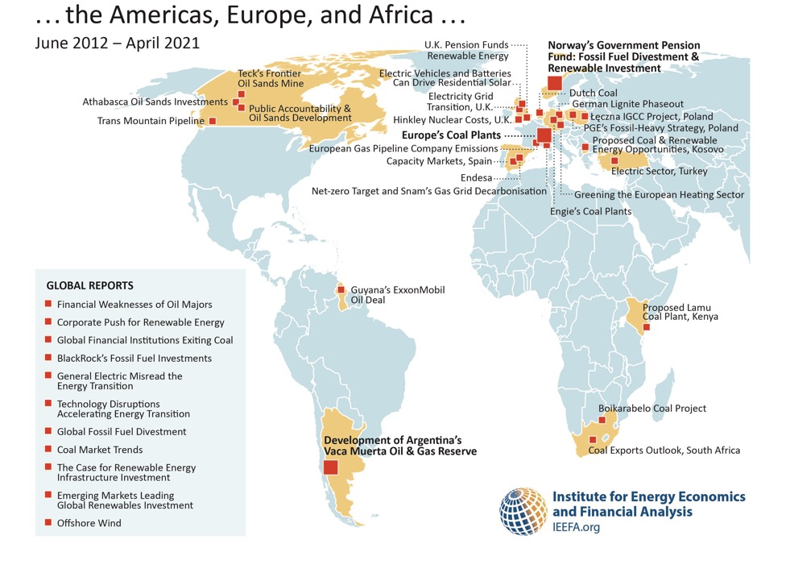
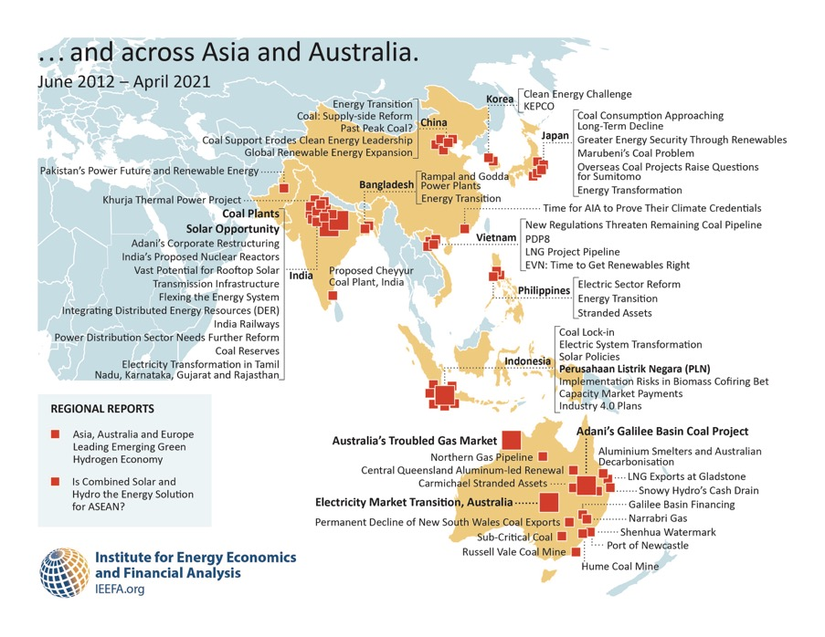
A snapshot of IEEFA

