Slide 1
Ukraine Impact on European Gas Markets
Difficulty Replacing Russian Imports Has Exposed Biased Network Design
Arjun Flora
May 19, 2022

Slide 2
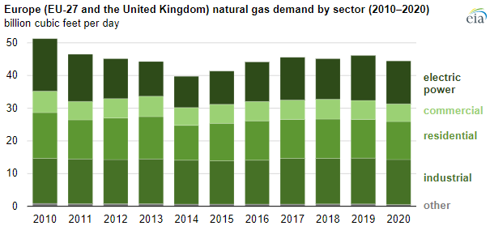
EU+UK Gas Demand
European gas demand has been flat, but reduced production means increased imports – historic reliance on Russian gas…
…used for power generation, buildings heating (and cooking), and as an industrial fuel and feedstock.
Source: U.S. Energy Information Administration, IHS Markit.
Notes:
International audience, provide some background
European gas consumption has not increased over the past deacade, instead it’s been fairly flat, reducing slightly.
However, the internal gas production is decreasing, which increases the need for import. ~80% of gas used in 2020 was imported
When it comes to pipeline gas, there are not many alternatives besides Russia. Norway delivers the volumes it has and the forecasted outlooks for more gas from Africa are not uplifting
1bcf/d ~= 10bcm/y

Slide 3
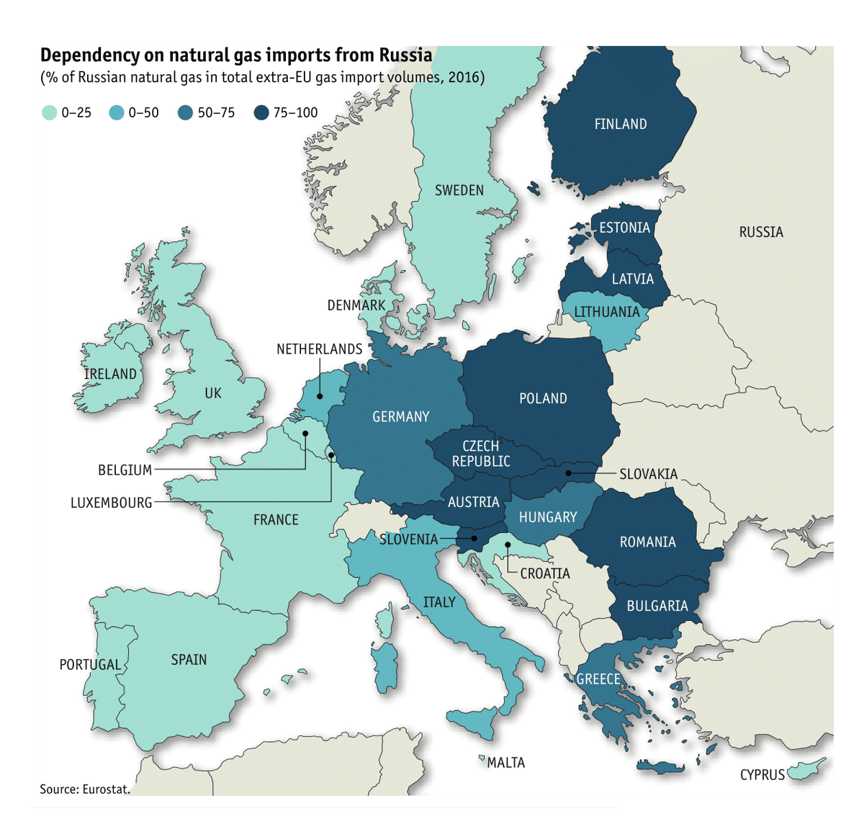
European Nation Dependency on Russian Gas Imports
But it’s not that simple…
…Russian gas dependency varies significantly among European nations…
Source: Eurostat.
Notes:
[Notes]

Slide 4
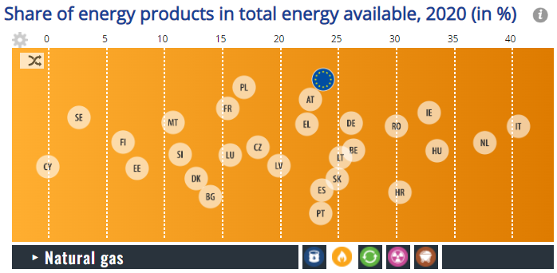
Gas % Share of Gross Inland Consumption, by EU Nation
…and overall, gas is much more important in some nations’ energy mixes than others.
Source: Eurostat.
Notes:
Why is this important? Makes it difficult politically to agree on coordinated responses
Reference to difficulty of imposing embargos against Russian coal, oil, gas, uranium

Slide 5
Gas prices have been at record highs since last year, partly caused by reduced supplies from Russia…
…this has caused widespread disruption – and prices have continued to rise since Russia’s invasion of Ukraine, with high volatility.
June 2022 gas futures contract pricing
Dutch TTF (€/MWh)
UK NBP (p/th)
Source: ICE Futures Europe.
Notes:
Unprecedented high gas prices: Both TTF and NBP broke records in the second half of last year
EU highlight exposed as most contracts are linked to spot prices, rather than oil in the past… good during low prices 2 years ago but bad now
Caused some demand destruction: fertilizer plant stopped producing; power sector switching from gas to coal, nuclear power plant lifetimes have been extended (Belgium, Finland) Major government intervention to cushion the impact of high prices to gas-exposed industries and to the most vulnerable consumers
High volatility means big swings in response to news from Western powers on sanctions or from Russia about cutting off supplies
Another way of looking at it, clear weaponization of Europe’s gas dependency by Russia
Dutch Title Transfer Facility; UK Net Balancing Point

Slide 6
[ ]
Despite EU efforts to diversify its gas supply since the early 2000s...
…the bloc has actually increased its dependence on Russian gas.
Why?
Source: U.S. Energy Information Administration, IHS Markit.
Notes:
Chart shows EU+UK at over 30%, EU alone was over 40% in 2021
Russian aggression: Annexation of Crimea in 2014, gas was cut-off from some countries in Eastern Europe
Why has this happened? Cost and complacency: Russian piped gas is cheap, close whereas LNG is more expensive has to be shipped in.
BUT a major cause has been the planning/approval process for gas infrastructure, dominated by vested interests, lack of independence
Flawed definition of energy security which has focused only on diversifying supply routes rather than the actual source of gas, i.e. building more pipelines and terminals but not necessarily in the right places.

Slide 7
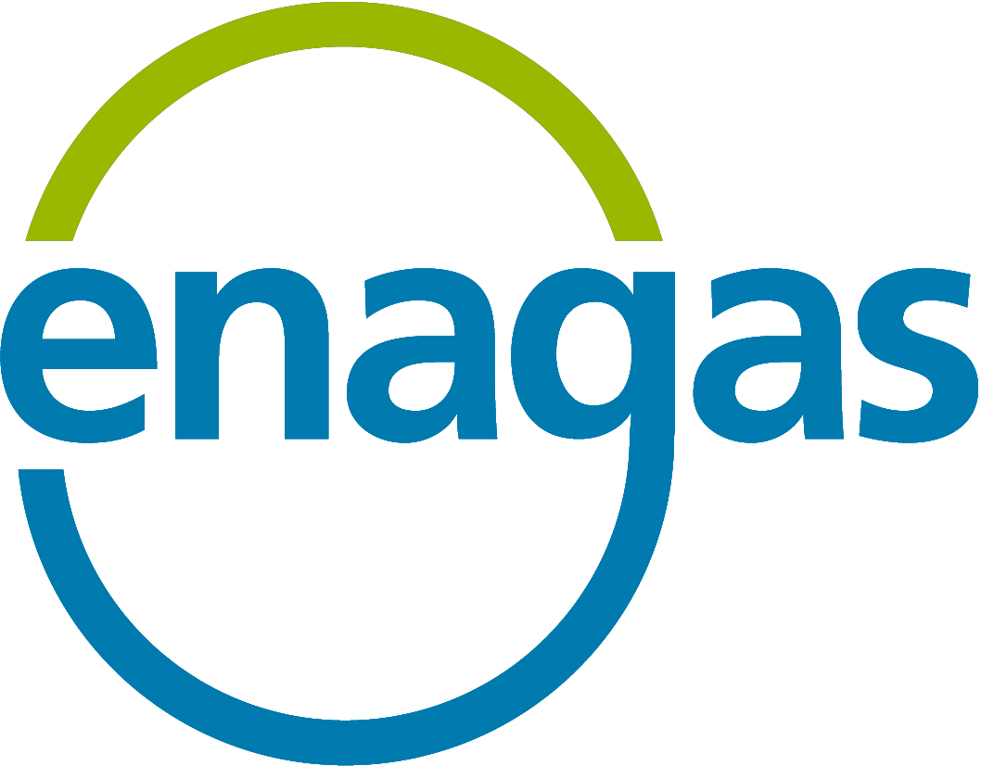
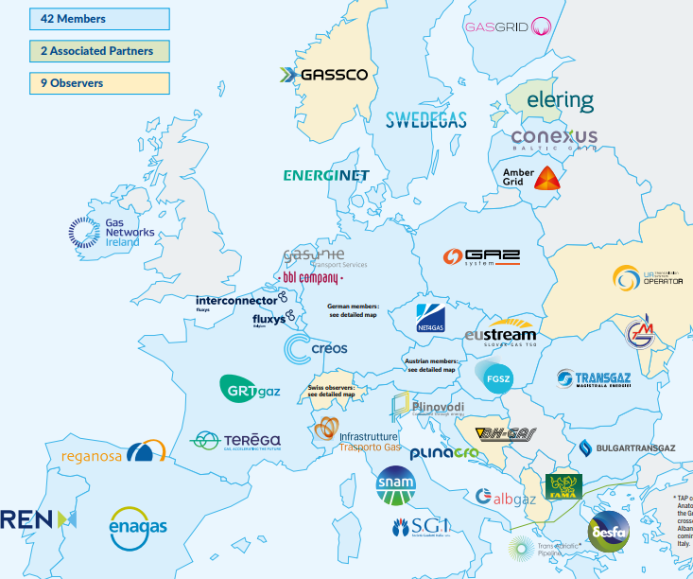
The European Network of Transmission System Operators for gas (ENTSO-G) is given responsibility for planning and proposing gas infrastructure across the EU…
…these nationally regulated private monopolies wield huge political influence and receive guaranteed returns for infrastructure investments.
Associated lobby groups…
+ others…
Notes:
Introduce ENTSO-G,
Historical lack of independent regulatory scrutiny and oversight, lack of teeth / resources to challenge these companies and their decisions
Many examples of this, which we’ve been pointing out in detail in our reports,
; IEEFA reports have highlighted mis-alignment of incentives: Enagas overbuilding terminals in Spain, Fluxys building out transhipment capacity in Belgium, Snam and Enagas pushing for gas and hydrogen use in cars trucks and buses, greenwashing by all these companies… just look at the colour of these logos. There is a long list of examples…

Slide 8
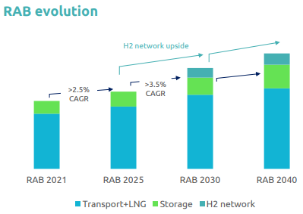
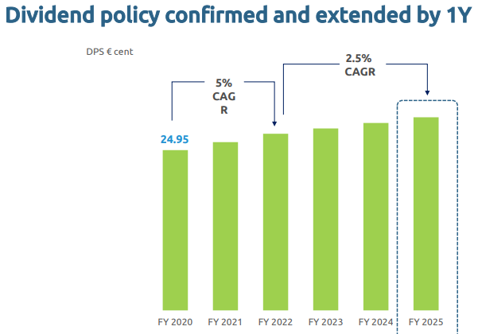
[ ]
ENTSO-G companies are incentivized to expand infrastructure, via regulated asset base (RAB) –based business models…
…this conflicts with reducing gas demand and is no longer fit for purpose, as IEEFA reports have repeatedly shown
European Gas TSOs are heavily biased towards building more pipelines, terminals and storage to increase their RAB and shareholder dividends
Result 1 = Overbuild of infrastructure in the wrong places
Result 2 = Lobbying for more gas-based infrastructure and more use of gaseous fuels (fossil gas, biomethane, synthetic methane, hydrogen, CO₂)
Source: Snam
Notes:
The RAB-based business model causes TSOs to lobby for increased use of gas, for example in transport and other sectors where electrification makes more sense. It is also behind initiatives such as Gas for Climate and others, which are pushing for favorable regulations supporting a new hydrogen network across Europe
Massive conflict of interest – saw earlier that European demand is not increasing, yet they are promising investors a stable and growing stream of dividends

Slide 9
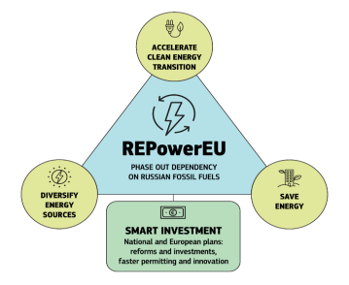
The Ukraine invasion has forced leaders to get off Russian gas… REPowerEU plan announced yesterday
…immediate term replacement of Russian gas supplies
…medium term reduction of gas demand (30%+ by 2030) via energy transition
REPowerEU
Joint purchasing of gas to increase buying power and remove competition between member states
Transparent sharing of gas storage capacity between states, plus a requirement to fill to at least 80% by November 2021 and 90% before following winters
IEEFA: Question marks over hydrogen regulations and financing – risk of ENTSO-G interests creating overbuild of hydrogen infrastructure
Source: European Commission, IEEFA
Notes:
Increased 2030 targets for deployment of renewable energy generation and energy efficiency
Gas storage: Eu Council and Parliament reach a provisional agreement today on legislation to fill gas storages by 80% by November and 90% before following winter periods. Also enables sharing of storage facilities between member states

Slide 10
Recap
Europe is dependent on Russian gas, some countries more than others.
Europe was already facing a gas price crisis before the invasion, partly caused by reduced Russian flows.
The Ukraine crisis has highlighted flaws in Europe’s gas network design, with gas unable to flow to where it is needed without Russian supply.
These flaws have been caused in part by profit-focused gas companies, whose vested interests have been allowed to distort the network planning process.
Europe seeks short term price and supply fixes, but this demand will be temporary.
REPowerEU, announced yesterday; overall positive, EU plans to reduce Russian gas dependence and gas demand by 2030 – some question marks around hydrogen planning
Ukraine Impact on European Gas Markets

