Slide 1
The Ukraine Crisis and its Impact On Global LNG Markets
Perspectives from the U.S., Europe, and Asia
Clark Williams-Derry
Arjun Flora
Ana Maria Jaller-Makarewicz
Sam Reynolds
May 19, 2022

Slide 2
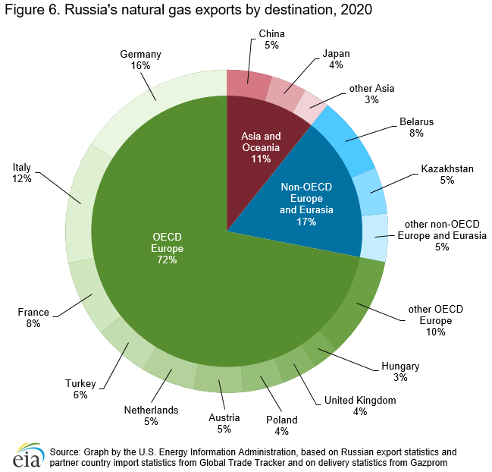
Russia Is a Key Player in Global Energy Markets
Largest gas exporter.
  ~34% of European gas supply from Russia.
Second largest natural gas producer.
Third largest oil producer.
Sixth largest coal producer.

Slide 3
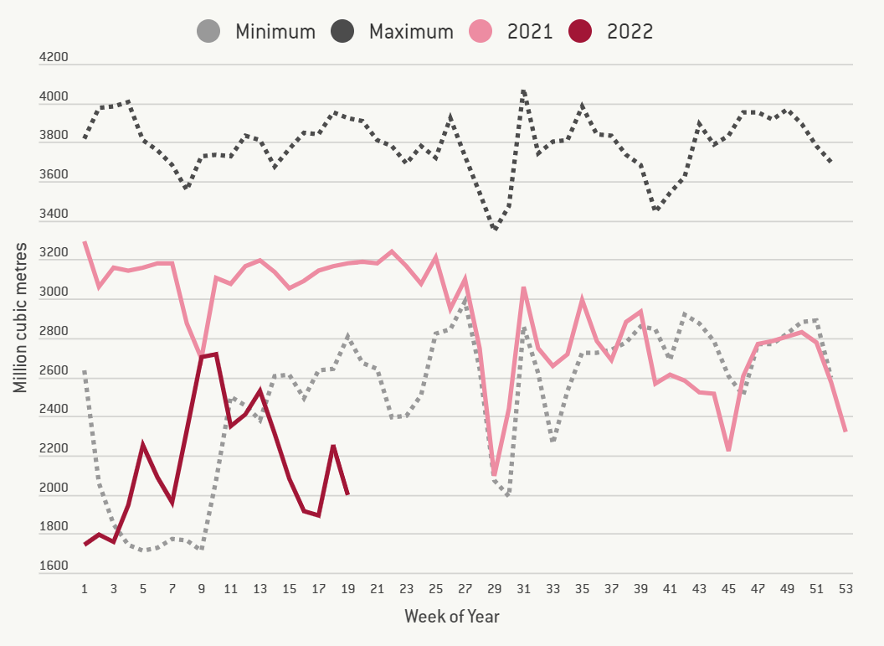
EU Imports of Russian Gas Disrupted
Following Russian invasion:
  EU plans to cut imports from Russia (155 Bcm) by two-thirds by end-2022.
  Mainly by increasing LNG imports by 50 Bcm.

Slide 4
Total LNG Traded in 2021:
383 Bcm

Slide 5
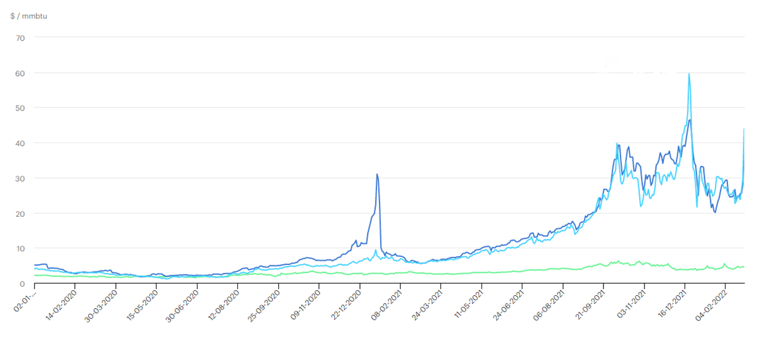
Prices Determine Destination
Europe Spot Price
Asia Spot Price
Henry Hub

Slide 6
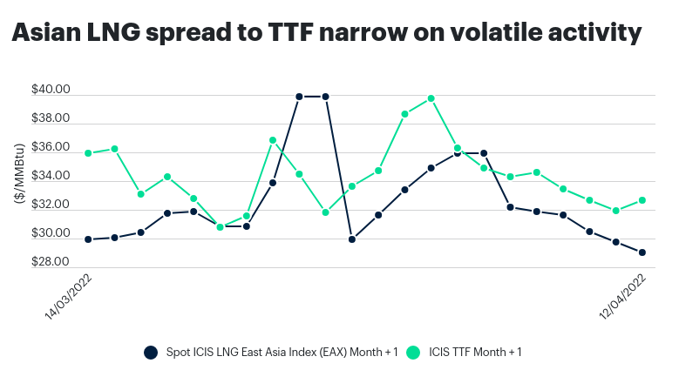
Zooming in on the Spread

Slide 7
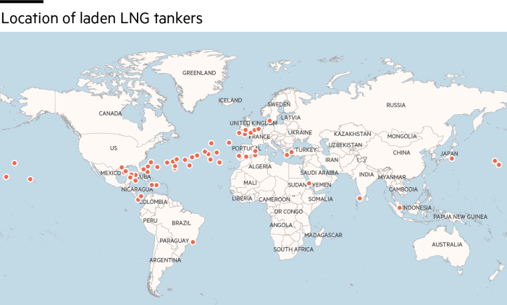
U.S. Cargoes Head to Europe to Capture High Prices
2021:
March 24, 2022:
47% of U.S. LNG export to Asia

Slide 8
Response from Asia

Slide 9
Exiting Spot Markets En Masse

Slide 10
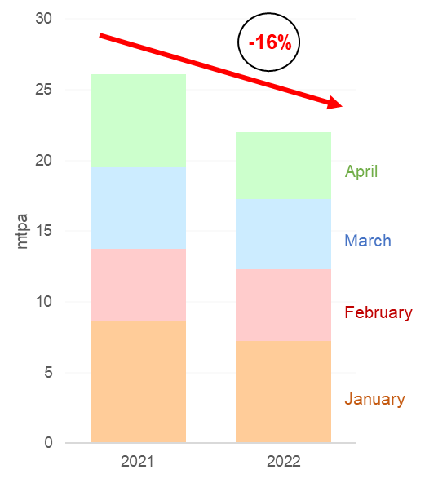
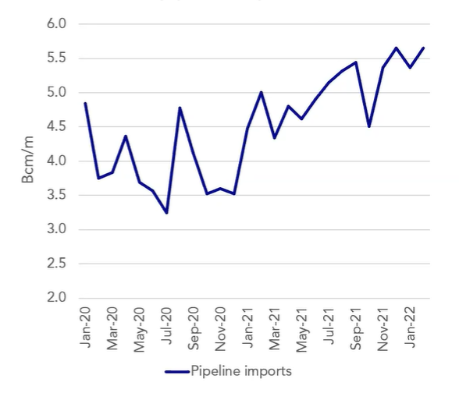
China
Demand down 16% YTD, due in part to strict COVID-19 lockdowns.
But pipeline imports are up 60%, with plans to expand Russian connections.

Slide 11
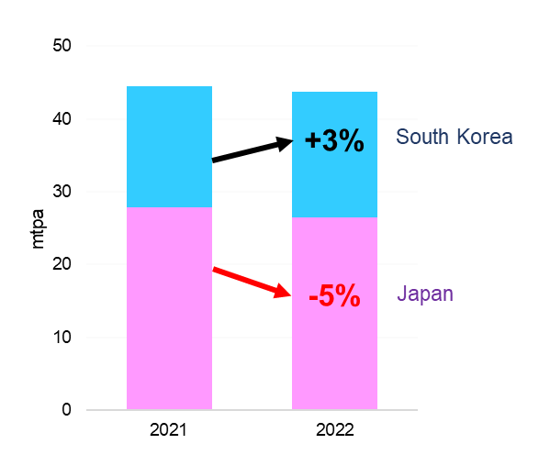
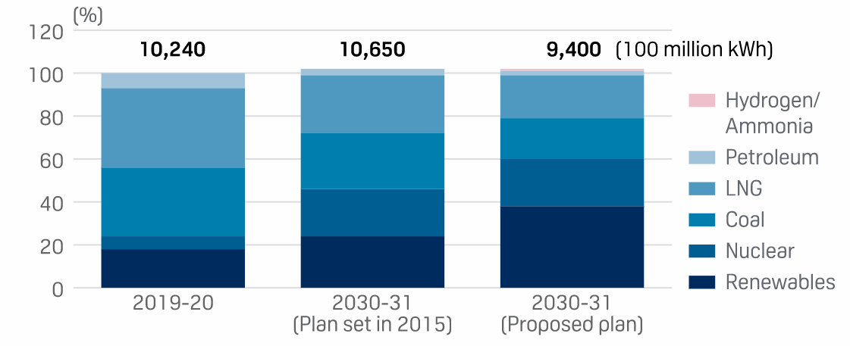
Japan and Korea
Many expect NE Asian to resume purchases in the summer to refill storage.
But long-term plans in Japan indicate shift away from LNG.
20%
37%

Slide 12
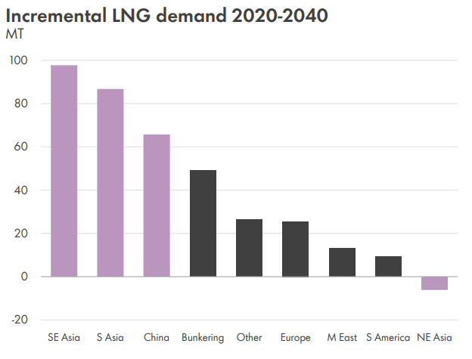

Slide 13
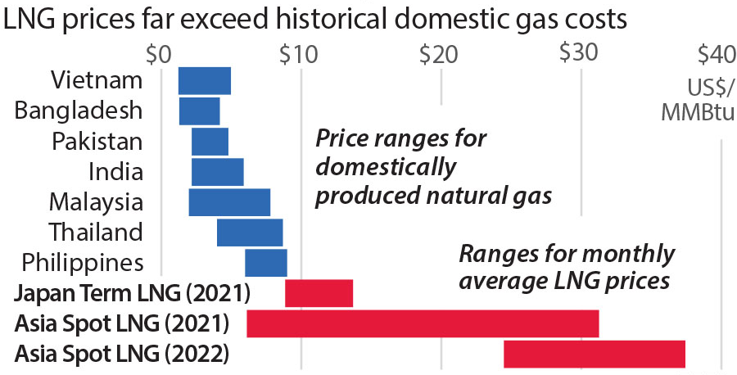
Demand Growth Depends on LNG Affordability

Slide 14
Buyers May Be Crowded Out of the Market
Price-sensitive buyers in Asia could be forced out of LNG markets for the next several years, exacerbating energy insecurity and heightening stranded asset risks.
India
Thailand
Pakistan
Myanmar
Price spikes and supply disruptions resulting from the Russia-Ukraine crisis have strengthened the economic case against LNG imports in Asia.
Indonesia
Malaysia
Bangladesh

